Slide 1
Working Together to Safeguard Children
Tuesday, 06 January 2026
Foundation Training

Slide 2






Housekeeping

Slide 3
Today’s learning outcomes:
By the end of this course, you will be able to:
Define what is meant by the terms ‘Safeguarding’ in relation to children
Recognise how society’s beliefs, values and attitudes, procedures and laws about children and child abuse have changed over time to put children first in all aspects of practice
List the four main categories of abuse, as well as their signs and indicators, and identify current and emerging risk
Identify at least 5 barriers/enablers that prevent/support children and young people from being effectively safeguarded
Respond effectively to concerns about the safety and welfare of a child/young person following their organisation and Safeguarding Partnership Jersey (SPJ) Policy and Procedures

Slide 4
Our Learning Agreement.
Offer criticism constructively
Have respect for the feelings, experiences and perspectives of others
Be aware of diversity issues and promote anti-oppressive practice
Respect confidentiality (excluding risk)
Participants to take responsibility for their learning

Slide 5

Wellbeing

Slide 6
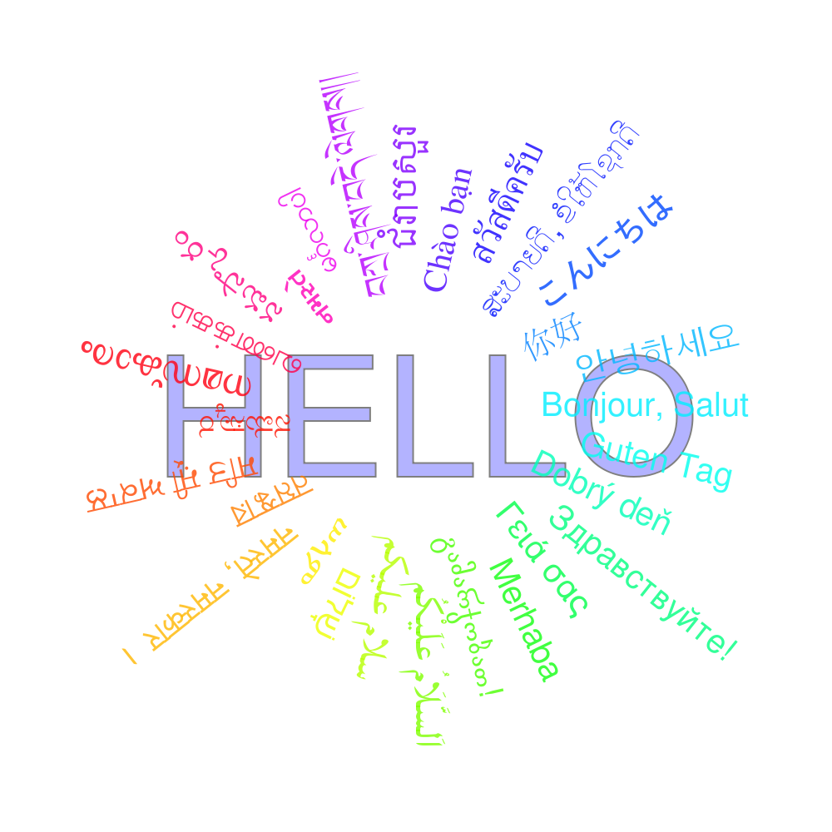
Introductions

Slide 7
Quiz – True or False

Slide 8

What do we mean by Safeguarding?
Group discussion
Notes:
Activity 2 DEFINE what is meant by safeguarding , split into groups encourage discussion 5 mins -
protection from abuse/neglect/harm ,
help reach full protentional
The aim of the activity is to understand the meaning of safeguarding
Expand – who is responsible - everyone - duty of care

Slide 9
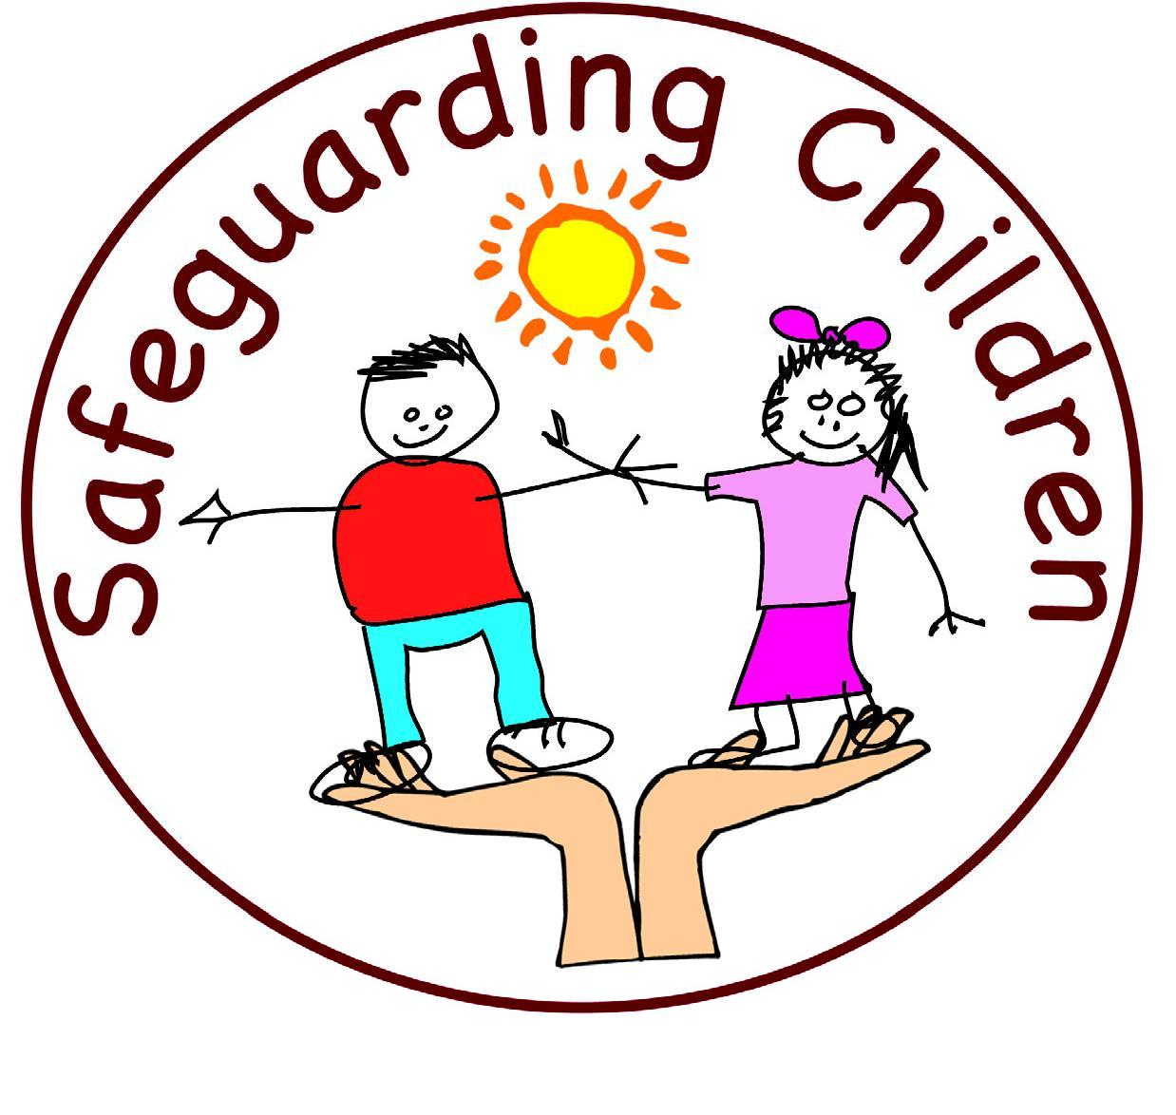
Safeguarding
Safeguarding means acting to protect children, young people and adult’s rights to live a life in safety, free from harm, abuse, neglect and exploitation.
Promoting Wellbeing and Safeguarding children, young people and adults is a collective responsibility and is an integral part of providing high quality care.
Safeguarding Partnership Jersey
Child Protection Procedures.
Notes:
This is safeguarding definition

Slide 10
Safeguarding Need
A Safeguarding Need (previously Child Protection) refers to the activity that is undertaken to protect specific children who are suffering, or are likely to suffer, significant harm.
Effective Safeguarding is essential as part of wider work to promote the welfare of children. However, all agencies and individuals should aim to proactively safeguard and promote the welfare of children so that the need for action to protect children from harm is reduced.

Slide 11
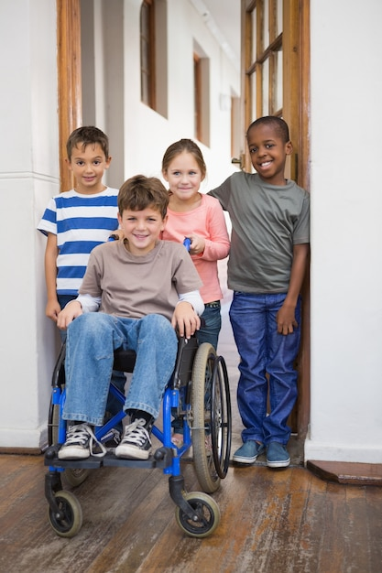
Jersey’s Children First
Jersey’s Children First is the vehicle for delivering the 5 outcomes of The Children and Families Plan 2024–2027. It is the Government's strategic plan to align systems and agencies, ensuring all children have an equal opportunity to be safe, thrive, and reach their potential through five key outcomes:
Live healthy, happy lives.
Learn and achieve.
Enjoy a decent standard of living.
Grow up safely.
Be included, respected and valued.
It is a mandatory requirement that Practitioners work together effectively to meet wellbeing, health and development needs and to promote and safeguard the welfare of children and young people.
Notes:
Highlight this is the island plan, and further information can be found on gov.je the previous plan had 4 outcomes, the new plan has added Enjoy a decent standard of living.

Slide 12
Jersey’s Children First
Standard framework.
Sets out how to work together to ensure children, young people and their families can access the right help at the right time from the right services.
Envisions a seamless multi-agency approach so that resources, information and support move with the child as they grow and develop.
At its heart is a commitment to early intervention and prevention for children which is coordinated around children and families when needed.
Information on how to access this training is at gov.je
Notes:
There is a step up/down approach - next slide shows the continuum of need model
Focus - Pre birth to 19 years

Slide 13
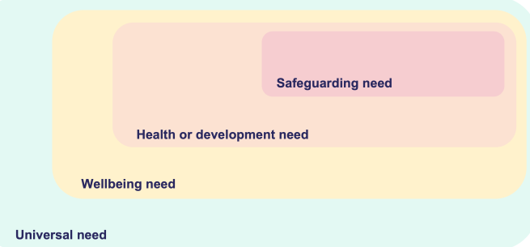
Jersey’s Children First
Informed by the Children (Jersey) Law 2002 and Children and Young People (Jersey) Law 2022 Statutory Guidance, the Continuum of Need tool identifies four levels of vulnerability, risk and need to assist practitioners to identify the more appropriate service response for children and their families. These are:
Child Protection
Child in Need
Early Help
Universal Need
Notes:
Children can move between the different levels
Safeguarding need ( child protection ) – no consent required – likely or is suffering from significant harm.,
Health and development need (child in need) no consent required – complex needs and need to support for health /disability would have SW , CAMHS pediatrician
Wellbeing need ( early help) consent required to share child may need emotional support, or family support
Universal need – consent required - share information shelter, food, clothing, medical care and protection from harm.
Right help at the right time
Knowledge is required at practitioner level, but it is useful to know the terminology and how the children may step up or down between the levels.

Slide 14
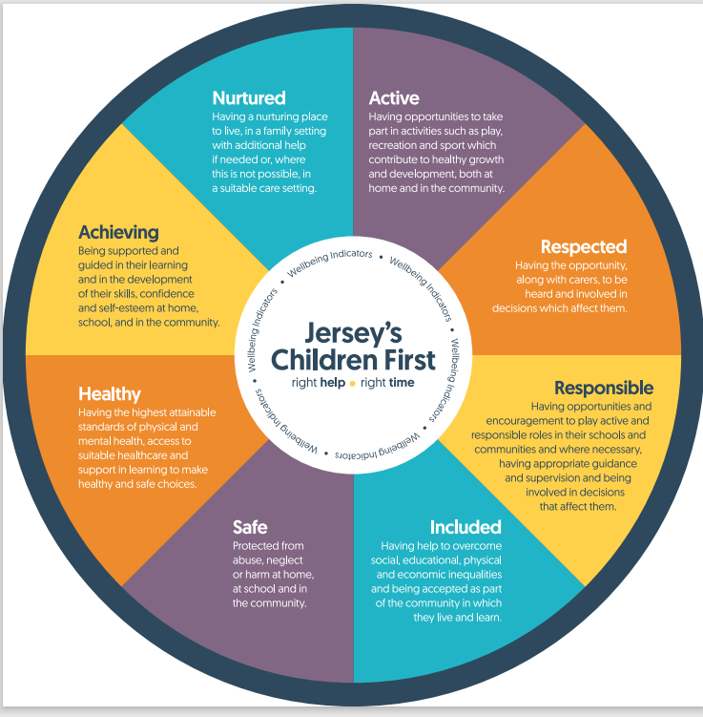
Children and Young People (Jersey) Law 2022
Notes:
These are the 8 wellbeing indicators prescribed in the Law. The wheel is a tool to help identify wellbeing needs in children and use of the language helps in the referral process, along with the continuum of need document.

Slide 15
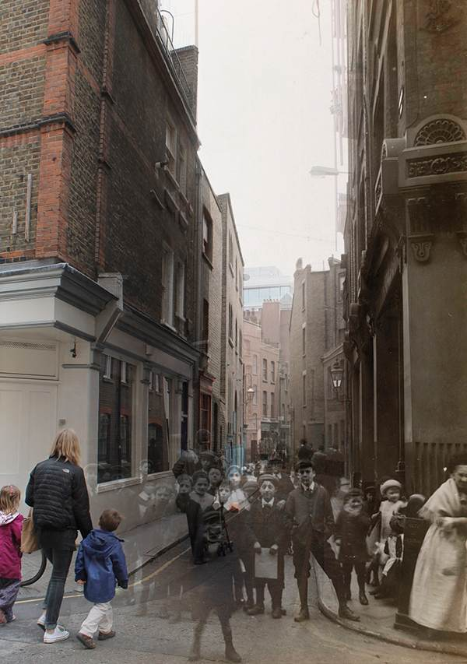
Child Abuse: A timeline of changing beliefs, values and attitudes.
Notes:
Activity 3 groups – put the timeline papers in the correct order that you think that these occurred – 10 mins

Slide 16
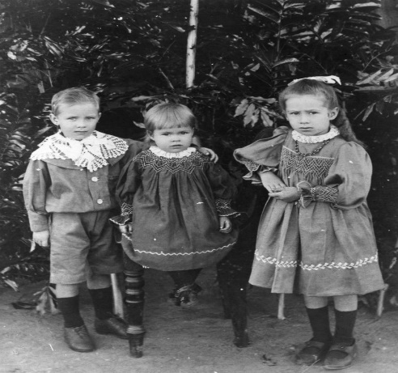


1908 Juvenile courts introduced & sexual abuse by a family member became a legal matter rather than a church matter. Registration of foster parents was introduced.
1978 Child “pornography” was outlawed.
1989 Children were given the right to protection from abuse and exploitation by the Children Act. It also introduced the concept of parental responsibility.
1991 UN Convention on the Rights of Child was ratified in UK. Extended to Jersey in 2014.
Notes:
1978 refer now as indecent images not pornography
Other changes 1973 – leaving school aged raised to 16

Slide 17
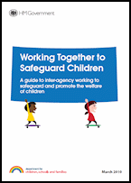

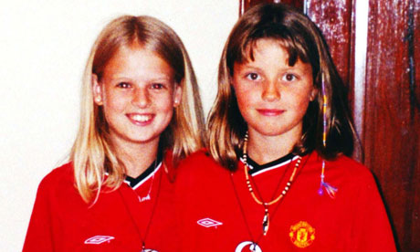
1999 Statutory Guidance ‘Working Together to Safeguard Children was released’ outlining the ways in which individuals and organisations should work together to promote the welfare of children and young people in accordance with the Children Act 2004. This guidance was reviewed in 2018.
2002 The Children (Jersey) Law.
2004 The Bichard Inquiry into the Soham murders (Holly Wells and Jessica Chapman) recommended a registration scheme for those working with children and vulnerable adults. This resulted in the Independent Safeguarding Authority responsible for the Vetting and Barring Scheme.

Slide 18

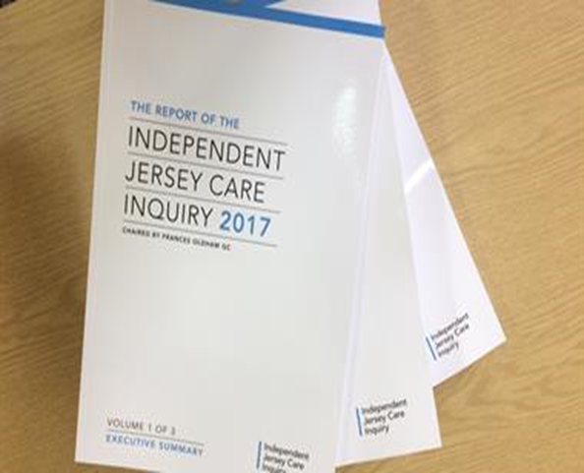

2016 The Capacity and Self-Determination (Jersey) Law introduced that everyone over the age of 16 must be assumed to have capacity, unless shown otherwise. The Law came into force in 2018.
2017 Independent Care Inquiry published, and Jersey’s Children’s Commissioner appointed.
2018 Sexual Offences (Jersey) Law offers greater protection to victims including up skirting and FGM. It also widens the definition of ‘positions of trust’ and clarifies issues around consent.
2018 also saw the launch of a new standard practice model in Jersey – Jersey’s Children First.

Slide 19
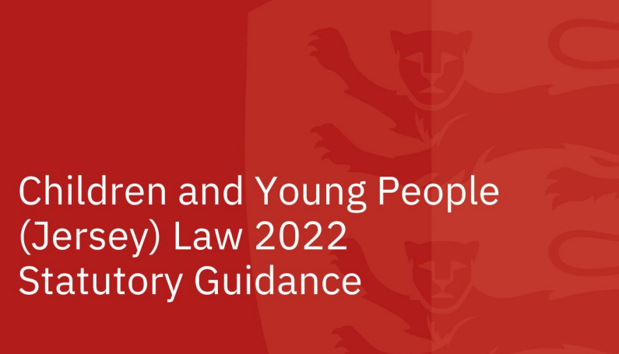
2024 the Children and Young People (Jersey) Law 2022 is enacted. Statutory guidance is published and online training provided alongside Safeguarding Arrangements documents.
Notes:
Following the death of Sara Sharif August 2023 the UK have already changed the Children's Wellbeing and Schools Bill which now makes it illegal for children to be homeschooled if the child's situation is being investigated by social services or if the child is on a child protection plan.
Further checks are being introduced in Jersey, but there in no automatic right for a child to be homeschooled known as Elective Home Education . By Law the Minister for Education and lifelong learning (Rob Ward) is responsible for ensuring school age children receive education through school or EHE, CYPES has to approve this, considerations are in place before this is granted.

Slide 20
In summary
Our values, beliefs and attitudes towards children have changed dramatically over the past few hundred years. We now have a duty to listen to children and put them first. Is this enough? What will future generations think of how we treat children now?
We still haven’t got it right - in all areas of practice.
Access to online-facilitated abuse and the sexual and criminal exploitation of children and young people are just two of many new issues for safeguarding.
We must adapt our practice and laws to change with the times to ensure children are protected from harm.
AND……continue to listen to children and put them first.

Slide 21

Categories of Abuse.
Activity
Notes:
4 categories on flip chart – what each is,
Group work – ask group to identify common indicators of abuse in all categories
Then consider indicators for each category in the following ages
0-1 babies
2-5 pre school
6 – 12 year
13- 18 years
Now think of a child with a disability how would that make them more vulnerable think about sensory impairment , ESOL , ethnicity, SEND.

Slide 22
Physical Abuse
Physical abuse happens when a child is deliberately hurt, causing physical harm. It can involve hitting, kicking, shaking, throwing, poisoning, burning or suffocating.
It’s also physical abuse if a parent or carer makes up or causes the symptoms of illness in children. For example, they may give them medicine they don’t need, making them unwell. This is known as fabricated or induced illness (FII).
Some of these signs include:
• Bruises, broken bones , cuts, burns, scalds
It may involve:
• Hitting, kicking, shaking
• Throwing, poisoning, burning
• Scalding, drowning
• Any other method of causing non-accidental harm to a child
Definitions and signs of child abuse |
NSPCC Learning

Slide 23
Sexual Abuse
These may include:
bruising or bleeding near the genital area
discomfort when walking or sitting down
an unusual discharge
sexually transmitted infections (STI) pregnancy
Changes in mood or behaviour
anal or vaginal soreness or itching
Sexual abuse is forcing or enticing a child to take part in sexual activities. It doesn’t necessarily involve violence, and the child may not be aware that what is happening is abuse.
Child sexual abuse can involve contact abuse and non-contact abuse.
Definitions and signs of child abuse | NSPCC Learning

Slide 24
Neglect
Some of these signs include:
children who appear hungry - they may not have lunch money or even try to steal food
children who appear dirty or smelly
children whose clothes are inadequate for the weather conditions
children who are left alone or unsupervised for long periods or at a young age
children who have untreated injuries, health or dental problems
children with poor language, communication or social skills for their stage of development
children who live in an unsuitable home environment
Neglect is not meeting a child’s basic physical and/or psychological needs. This can result in serious damage to their health and development.
Definitions and signs of child abuse | NSPCC Learning

Slide 25
Emotional Abuse
Babies and pre-school children who are being emotionally abused may:
• be overly-affectionate towards strangers or people they haven’t known for very long
• not appear to have a close relationship with their parent, for example when being taken to or collected from nursery
• lack confidence or become wary or anxious
• be aggressive or nasty towards other children and animals.
Older children may:
• use language, act in a way or know about things that you wouldn’t expect for their age
• struggle to control strong emotions or have extreme outbursts
• seem isolated from their parents
• lack social skills or have few, if any, friends
• fear their parent being approached regarding their behaviour
• self-harm.
Emotional abuse is the ongoing emotional maltreatment of a child, which can have a severe and persistent negative effect on the child’s emotional health and development. It's also known as psychological abuse.
Definitions and signs of child abuse | NSPCC Learning

Slide 26
In Summary
Recognising signs of abuse in children can be challenging, as they may be behavioural, emotional or physical.
Understanding child development helps in spotting subtle signs and early detection improves outcomes.
Building strong relationships allows for identifying when a child’s behaviour changes, prompting curiosity about underlying causes.
Providing space and tools for communication is essential, especially for babies, young children, those with disabilities or those with language barriers.
Adolescence is a time of experimentation, but curiosity is necessary to determine if there are deeper issues.
It's also important to consider the child's cultural and family background when identifying signs of abuse.

Slide 27
Current and Emerging Risks

Slide 28
Child exploitation - Sexual and Criminal.
Online & Digital risks - Cyber bullying, online harassment & AI.
Vulnerabilities in families - Domestic Abuse, Controlling Coercive Behaviour, substance misuse, parent/child mental health.
Radicalisation - Political, far right/left, ideologies, incels (involuntary celibates).
Modern Day Slavery - Domestic servitude.
Trafficking - County lines, Child Criminal Exploitation, Child Sexual Exploitation, forced labour.
Forced Marriage - Forced marriage by coercion/threat and without free will.
Female Genital Mutilation - Nonmedical procedure against women and girls.
And Covid…
…mental Health, social wellbeing affecting health and development.
Notes:
Covid – has led in some cases to children lacking in socialisation – think how lock downs prevented mixing and the impact. Developmental delay.
Some cases poor parenting children not toilet trained and when started nursery were behind the expected developmental milestones.
You could promote Brook Traffic Light training as it highlights normal and concerning behaviours. Incel is a term associated with a mostly online subculture of male heterosexual people who define themselves as unable to find a romantic or sexual partner despite desiring one, and who may blame, objectify and denigrate women and girls as a result.

Slide 29
Addressing Current and Emerging Risks

Slide 30
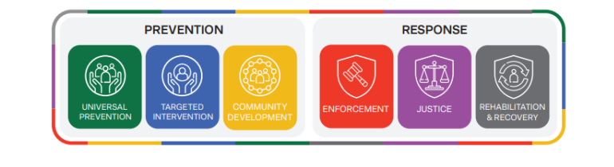
Building A Safer Community (BASC)
The purpose of BASC is to provide a framework that enhances the collective impact of partner agencies in protecting the community from crime.
Notes:
This is Jersey’s new community safety system, there are 2 main phrases , Prevention and response. Each phase has 3 pillars. The BASC Framework is the Government of Jersey’s collaborative approach to making the island safer for everyone. It brings together services, organisations, professionals, and the community to:
Prevent and respond to safety issues before they escalate
Share knowledge and data to better understand and address community safety issues
Promote collaboration
Reduce crime and reoffending
Ensure victims, witnesses, and affected communities receive the support they need to recover and thrive
Universal prevention
Focuses on preventing issues before they occur.
Address underlying risk factors, like supporting children’s social and emotional needs to reduce future criminality
Targeted intervention
Provide support when specific risks are identified.
Offer pre-emptive help to businesses, individuals, or families at risk of criminal behaviour.
Community development
Strengthen communities to reduce susceptibility to crime.
Leverage local assets (skills, resources) to build resilience and foster social innovations.
Response
address crime effectively and sensitively.
Support offenders, victims, witnesses, and the community in the aftermath.
Enforcement
Investigate and prosecute crimes.
Support victims and witnesses to reduce trauma.
Justice
Formal court proceedings from charges to sentencing.
Focus on supporting victims and witnesses during the process.
Rehabilitation and recovery
Help offenders reintegrate and reduce reoffending.
Support victims and the community in healing from the harm caused.

Slide 31
Violence Against Women & Girls (VAWG)
Violence against women and girls is any act of gender-based violence that results in, or is likely to result in, physical, sexual or psychological harm or suffering to women, including threats of such acts, coercion or arbitrary deprivation of liberty, whether occurring in public or in private life.
Violence against women and girls refers to acts of violence or abuse that disproportionately affect women and girls. Although women and girls are mostly affected, men and boys can also be victims of this type of violence. Lesbian, gay, bisexual or transgender people can also be victims of this type of violence often due to their sexual orientation or gender identity.
You can be a victim or witness gender-based violence in your family, at school, at work, in the community or online. It can be committed by anyone.
VAWG Taskforce Report.pdf
Notes:
It can be committed by anyone:
current or previous spouse or partner
family member
school peers
work colleague
Friends
unknown person
Nb. this initiative does not negate/ignore the fact that males can be victims of violence and domestic abuse as well as females.

Slide 32
Child Exploitation
New Guidance and Chapters; Safeguarding Children from Criminal Exploitation
New Jersey Exploitation Screening Tool for multi-agency practitioners, completed by referring agency.
Child Exploitation Risk Assessment Information Form; information is assessed by MASH, CE lead (CSC), Police Detective Superintendent (DS)
Jersey Child Exploitation Pathways.
Notes:
In May 2025, new Child Exploitation Guidance and Chapters published to address the growing concerns around the exploitation of children and young and people in Jersey.
The screening tool is completed by the person referring to the children and family hub – usually a practitioner, it is then assessed using the risk assessment tool, by the hub and the professionals required and then a decision will be made about where the child will be in the pathway

Slide 33
Barriers to Safeguarding
Notes:
They may not understand what is happening to them – Disability, cognitive, it’s the “norm”
Guilt and blame
Ashamed embarrassed
People won't believe them
May not be able to communicate verbally – you would need to watch for signs of behavioral changes
Afraid of the consequences of speaking out
Hope that the abuse will stop

Slide 34

Enablers to Safeguarding
Notes:
Activity 6
Children – focus on what helps them tell
Positive relationships/good communication
Knowing who to tell
Knowing their rights
Being heard
Being believed /not judged
Adults
good training
Professional curiosity
Person centered
Empathy/non judgmental
Consideration of and for their needs

Slide 35
In Summary
Need to focus on what helps children tell.
Children need those around them to notice when they need to talk about themselves and what is happening in their lives.
Professionals and adults need to:
  ask children about their lives and wellbeing
  help them access someone they can trust
  let them know they will be taken seriously and help them understand that abuse is wrong.

Slide 36

Activity

Slide 37

Child Scenarios
What is getting in the way of this child’s wellbeing?
How might these issues be impacting on the child right now?
How might these issues impact on the child in future?
Are there additional needs that you should consider?
What will you do with this information?

Slide 38
Reporting Concerns

Slide 39
Who do I tell? Your line manager and/or DSL. In cases where the child is at immediate risk of harm (such as physical or sexual abuse) you should inform the Police. If you have a serious concern about the welfare of a child, you have a duty to contact the Children and Families Hub (see next slide).
When do I tell? As soon as possible but do not leave the child or young person in this process. If the child is at risk of immediate significant harm, contact the Police.
What do I need to do? Record information - what you’ve been told, seen, heard. Be sure to include dates, times and any other relevant information. Your DSL or Manager will support you and help decide whether or not to make a referral. If you are not happy with that decision you can refer directly to the Children and Families Hub.
What happens next? Depending on concerns the police and/or Children and Families Hub may need to take immediate action. Enquires are ‘RAG’ rated. Outcomes may include information kept on file, an initial assessment conducted by a social worker, integrated service involvement to support the child/family or no further action. The Children and Families Hub aim to get back to all referrals.

Slide 40
Children and Families Hub
The Children and Families Hub provides a single point of contact for children, young people and families who require additional support to ensure they are safeguarded and protected.
Contact the Children and Families Hub on 01534 519000 or email childrenandfamilieshub@gov.je
The Children and Families Hub electronic referral form (which replaces MASH Enquiry Form and Early Help Referral Forms) can be accessed at Children and Families Hub (gov.je)
Out of hours service will operate at other times. The Duty Social Worker can be reached by calling the Hub on 01534 519000 and selecting Option 4 or via the Hospital Switchboard on 442000.

Slide 41
Summary of Today’s learning
There are many common signs and indicators of abuse but above all you must base your concerns on your knowledge and understanding of that specific child and their circumstances and see what life is like for that child
There are many barriers that stop us from effectively safeguarding children and young people - be mindful of these and remember to never lose sight of the child and listen to their voice
It is important to share your concerns with your Line Manager or Designated Lead for any concerns you have. Remember your information may be a ‘vital part of the jigsaw.’ no matter how small.
SPJ Multi Agency Child Procedures are online www.safeguarding.je
Further training can be found on www.safeguarding.je
Jersey Children’s First Training can be found at www.gov.je/Caring/JerseysChildrenFirst/Pages/GuidancePractitioners.aspx
Island Plan can be found Children and Young People's Plan 2024 to 2027

Slide 42

Any Questions?

Slide 43

Further Learning
The SPJ website (www.safeguarding.je) has a series of 7 Minute Briefings on a range of topics which you can use with your teams to prompt discussion and reflection on practice and systems. You can find 7 Minute Briefings under the ‘Resources’ tab on the website – including an explanation of what they are.

Slide 44
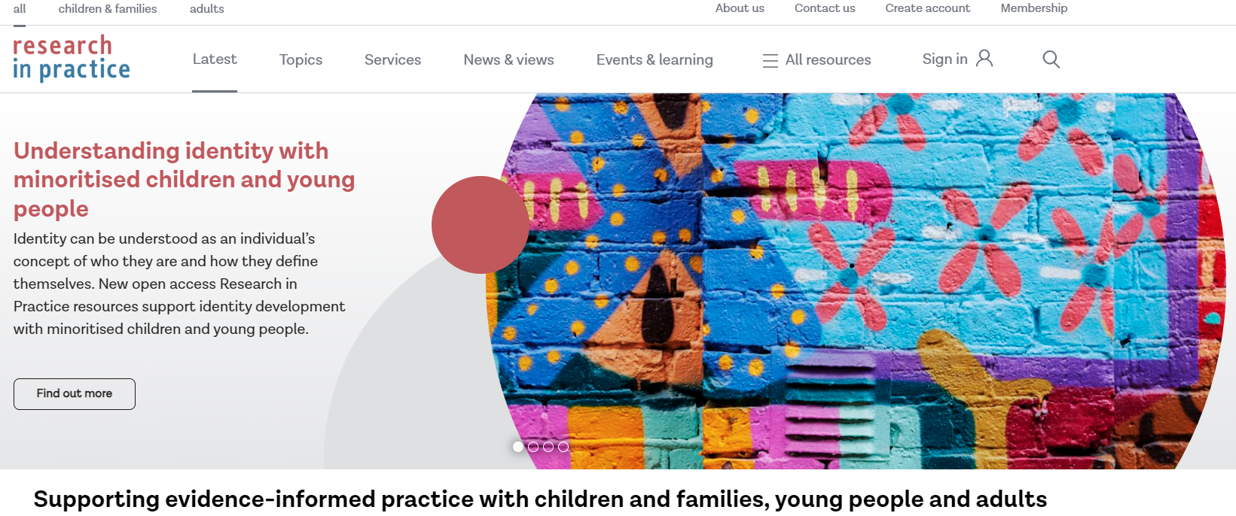

Further Learning
Materials are also available on the Research in Practice website.
Further training is available to book via the SPJ website.

