Slide 1
Working Together to Safeguard Adults at Risk Foundation Course
Tuesday, 13 January 2026

Slide 2






Housekeeping
Housekeeping

Slide 3
Today’s Learning Outcomes:
By the end of this course, you will be able to:
Define the term ‘Adult at Risk’ in relation to Adult Safeguarding and the criteria required to make a Safeguarding Enquiry.
Explain how the Safeguarding Adults procedure supports ‘Making Safeguarding Personal’.
List the 5 principles of Capacity as outlined in the Capacity and Self- Determination Law 2016.
List the 12 categories of abuse as well as their signs and indicators.
Identify at least 5 barriers that can prevent the effective safeguarding of an adult at risk.
Know when and to whom suspected abuse should be reported.

Slide 4
Our Learning Agreement:
Offer criticism constructively
Have respect for the feelings, experiences and perspectives of others
Be aware of diversity issues and promote anti-oppressive practice
Respect confidentiality (excluding risk)
Participants to take responsibility for their learning
Participants are learning resources as well as learners

Slide 5

Wellbeing

Slide 6

Introductions

Slide 7

Who is an “Adult at Risk”
In groups, define who is an “adult at risk”

Slide 8
‘Adult at Risk’ As stated in the UK Care Act 2014: An adult at risk refers to any adult aged 18 or over who
Has care and support needs (irrespective of whether such needs are being met)
Is experiencing, or is at risk of, abuse or neglect
Is unable to protect themselves because of their care and support needs
Everyone working to support people with care and support needs has a responsibility within these multiagency adult safeguarding procedures to identify and respond to concerns about possible abuse and neglect.
(SPJ Multi Agency Safeguarding Adults Policy and Procedures 2021)

Slide 9
An adult with care and support needs may be:
A person with a physical disability, a learning disability or a sensory impairment.
Someone with mental health needs, including dementia or a personality disorder.
A person with a long-term health condition.
Someone who misuses alcohol or substances to the extent that it affects their ability to manage day-to-day living.
Someone who is unable to demonstrate the capacity to make a decision relating to their safety and is in need of care and support.
(this list is not exhaustive)
Note: A person who is a carer can also be considered an adult risk if they meet the criteria for safeguarding.

Slide 10

Adult with Care and Support Needs. Yes or No?

Slide 11
Initiating Adult Safeguarding Procedure
A Safeguarding Adults Procedure would be initiated when an adult with care and support needs is experiencing abuse or is at risk of being abused and is unable to protect themselves because of their care and support needs.
Adult with Care and Support Needs + Abuse + Unable to protect themselves = Adult Safeguarding

Slide 12

Safeguarding – Yes or No?

Slide 13
In Summary
Not all adults with care and support needs will need a safeguarding enquiry.
If an adult needs extra support, contact Single Point Of Referral (SPOR) for a social care assessment.
If an adult with care and support needs is being abused and is unable to protect themselves, use the enquiry form and contact SPOR.
Consent has to be gained unless there is concern over capacity, risk to others or duty of care.

Slide 14
Human Rights

Slide 15

Human Rights are the basic rights and freedoms that belong to every person in the world from birth until death.
They can never be taken away, although they can sometimes be restricted or limited e.g. right to liberty.
These rights come from the European Convention on Human Rights which are written into the Human Rights (Jersey) Law 2000.
Human Rights should underpin all our work with people we are supporting.

Slide 16

The Capacity and Self Determination Law establishes safeguarding for people who lack capacity and ensures human rights principles are at the forefront of care and treatment for people who lack capacity
Relevant rights include:
Article 5: Right to liberty
Article 6: Right to a fair hearing
Article 8: Right to respect for private and family life

Slide 17

Making Safeguarding Personal (MSP)

Slide 18
Making Safeguarding Personal (MSP)
MSP is the way of working that promotes human rights.
MSP promotes responses to safeguarding situations in a way that enhances a person’s involvement, choice and control as well as improving quality of life, well-being and safety – “no decision about me, without me”.
Sees people as experts in their own lives, working alongside them to identify the outcomes they want with the aim of enabling them to resolve their circumstances and support their recovery.
MSP means that safeguarding:
Is person led
Enhances involvement, choice and control
Is outcome-focused
Improves quality of life, wellbeing & safety
Making Safeguarding Personal

Slide 19
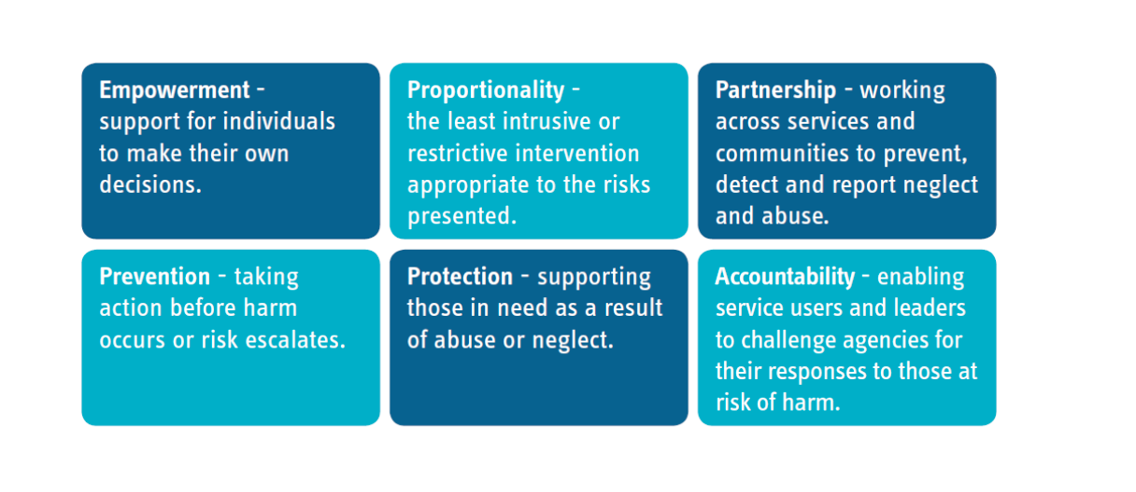
The 6 Principles of MSP – EPPPA People are experts in their own lives, “talk to me/listen to me”

Slide 20
Consent

Slide 21

Care Act 2014 (England and Wales/UK) - Consent
There is a duty of care to undertake an assessment of the adult’s care and support needs despite their refusal in cases;
where they lack capacity to refuse the assessment, and it would be in their best interests
where the adult is experiencing, or at risk of abuse or neglect, there is a duty of care to intervene, for example, a serious crime has been or may be committed or there is a serious risk to life
there is a risk to others.
In cases where the adult does not wish to co-operate with an enquiry or rejects any proposed safeguarding measures, genuine attempts will be made to negotiate and try and find areas of possible agreement.
(Recording these discussions is essential)

Slide 22

Explore the reasons for the adult's objections – what are they worried about?
Explain the concern and why you think it is important to share the information.
Tell the adult with whom you may be sharing the information with and why.
Explain the benefits to them, or others, of sharing information – could they access better help and support?
Discuss the consequences of not sharing the information – could someone come to harm?
Reassure them that the information will not be shared with anyone who does not need to know.
Offer the reassurance that support is available to them.

Slide 23

Capacity and Self Determination Law (2016)
The CSDL affects all people aged over 16.
The CSDL supports people’s decision-making, including future decisions.
The CSDL provides a legal framework for assessing capacity and making decisions for those who lack capacity.

Slide 24
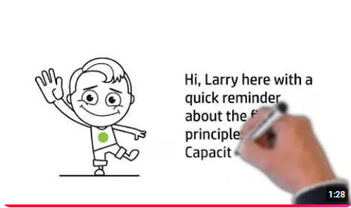
Explaining Capacity
The 5 Principles of the Mental Capacity Act

Slide 25
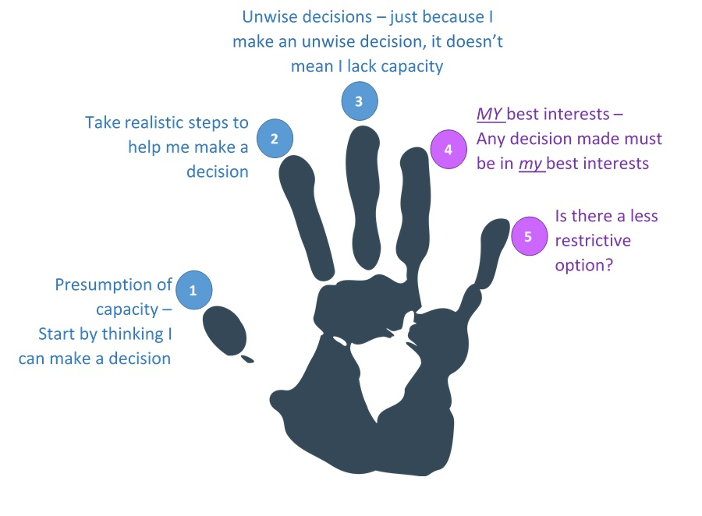
Five Principles of the Law
a person must be assumed to have capacity unless it is established that they lack capacity
a person is not to be treated as unable to make a decision unless all practicable steps to support them to do so have been taken without success
a person is not to be treated as unable to make a decision merely because they make an unwise decision
an act done, or decision made, under the Law for or on behalf of a person who lacks capacity must be done, or made, in their best interests
before an act is done, or a decision made which is restrictive of a person’s rights and freedom of action, regard must be had to whether the purpose for which it is needed can be achieved as effectively in a less restrictive way
The Capacity Law and its Code of Practice –
Jersey Court Service

Slide 26
What would you do?

Slide 27

Harry, a 35-year-old with capacity living in the community, falls and is unable to take care of his basic needs. Do you need his consent to contact SPOR for a social care assessment?
Sophie, a 35-year-old with complex needs, is being sexually abused by one of her care workers. Do you need her consent to report the abuse?
Gerry, a 50-year-old who has a disability but has capacity, lives in squalid conditions. A local gang is exploiting him for money and threatened violence if he does not comply. Do you need consent to make an Enquiry to SPOR?

Slide 28
Categories of Abuse and Common Indicators

Slide 29
Physical Abuse
The non accidental infliction of physical force that results (or could result) in bodily pain, injury or impairment.
Examples of physical abuse are:
Hitting
Slapping
Shaking
Misusing medication
Restraint
Exposure to heat or cold
Not giving adequate food or drink etc

Slide 30
Sexual Abuse
The direct or indirect involvement in sexual activity without consent.
Sexual Abuse includes:
Rape
Indecent assault and indecent exposure
The involvement of an adult at risk in a sexual activity or relationships which they cannot understand or have been coerced into because the other person is in a position of trust, power or authority

Slide 31
Psychological/Emotional Abuse
Psychological abuse is behaviour that has a harmful effect on the adult at risk’s emotional health and development
Psychological abuse includes:
Threats of harm or abandonment
Deprivation of contact
Humiliation
Intimidation
Harassment
Isolation or withdrawal from services or supportive networks

Slide 32
Financial or Material Abuse
Financial abuse is the use of a person’s property, assets, income, funds or any other resources without their informed consent or authorisation.
Financial Abuse includes:
Theft
Fraud
Exploitation
Undue pressure in connection with wills, property or inheritance or financial transactions
The misuse or misappropriation of property, possessions or benefit
The misuse of a Power of Attorney or Curatorship

Slide 33
Neglect or acts of omission
Neglect is the failure of any person who has responsibility for the charge, care or custody of an adult at risk to provide the amount and type of care that a reasonable person would be expected to provide.
Examples of neglect include:
Ignoring medical or physical needs
Failure to allow access to appropriate health, social care or educational services
Withholding the necessities of life such as medication, adequate nutrition and heating
Neglect can be intentional or unintentional.

Slide 34
Discriminatory Abuse
Discriminatory Abuse exists when values, beliefs, or culture result in a misuse of power that denies opportunity to some groups or individuals. It can be a feature of any form of abuse of an adult at risk, but can also be motivated because of age, gender, sexuality, disability, religion, class, culture, language, and ‘race’ or ethnic origin.

Slide 35
Institutional Abuse
Institutional abuse is the mistreatment, abuse or neglect of an adult at risk by a regime or individuals within settings and services that adults at risk live in or use, that violate a person’s dignity, resulting in lack of respect for their human rights.
Institutional abuse occurs when the routines, systems and regimes of an institution result in poor or inadequate standards of care and poor practice which affects the whole setting and denies, restricts or curtails the dignity, privacy, choice independence or fulfilment of adults at risk.

Slide 36
Self Neglect
The term “self-neglect” covers a wide range of behaviour neglecting to care for one’s personal hygiene, health or surroundings. Examples of self-neglect include:
A refusal or inability to cater for basic needs, including personal hygiene and appropriate clothing
Neglecting to seek assistance for medical issues
Not attending to living conditions – letting rubbish accumulate in the garden, or dirt to accumulate in the house
Hoarding items or animals
The dilemma of managing the balance between the protection of adults at risk from self-neglect, our duty of care and an individual’s right to self-determination is a recognised challenge for all services.

Slide 37
Domestic Abuse
Any incident or pattern of incidents of controlling, coercive, threatening behaviour, violence or abuse between those aged 16 or over who are, or have been, intimate partners or family members regardless of gender or sexuality.
Domestic abuse can take many forms:
Physical
Emotional
Sexual
Financial
Honour Based Violence
Forced Marriage
Stalking and Harassment
The Domestic Abuse (Jersey) Law 2022 was enacted 21/06/2023.

Slide 38
Female Genital Mutilation
FGM is a collective term for procedures which include the removal of part or all the external female genitalia for cultural or other non-therapeutic reasons. The practice is medically unnecessary, extremely painful and has serious health consequences. The procedure is typically performed on girls aged between 4 and 13, but in some cases, it is performed on young women before marriage or pregnancy.
FGM usually happens to girls whose mothers/grandmothers or extended family have had FGM or if their father comes from a practicing community. Therefore, if you become aware of FGM in adults, you should ‘think family’ and consider whether there are risks to any female children in the family.

Slide 39
Modern Slavery
Modern slavery includes offences such as human trafficking, slavery, servitude, and forced labour. Victims, both adults and children, are exploited in various ways, with sexual exploitation, labour exploitation, and criminal exploitation being the most common in the UK. Other forms of exploitation include domestic servitude and organ harvesting.
Modern slavery crimes include facilitating travel to exploit a person. While trafficking often involves crossing borders, it can also happen locally. Victims can be exploited even with consent to move, but children cannot consent to exploitation, so coercion or deception isn’t required to prove an offence. Jersey is not exempt—modern slavery has grown in the UK, and similar crimes can occur here.

Slide 40
Hate and Mate Crime
Hate and Mate Crime refers to acts of violence or hostility directed at people due to who they are or who someone perceives them to be. Hate crimes are motivated by prejudice based on disability, race, religion, sexual orientation, or gender identity. Mate crime, on the other hand, occurs when someone befriends a vulnerable person with the intention to exploit them financially, physically, or sexually. The relationship starts as a fake friendship, but the perpetrator’s goal is criminal, and it often leads to ongoing abuse.
People with learning disabilities are especially vulnerable to mate crimes because they may live isolated lives and are more likely to trust others for companionship. Due to limited "streetwise" experience, they are more susceptible to exploitation in the community, on public transport, or while using services without proper support.

Slide 41

Scenarios Activity

Slide 42
Barriers to Safeguarding

Slide 43
Know when & to whom abuse should be reported

Slide 44
1. If you have any safeguarding concerns about the welfare or safety of an adult at risk you should discuss this with your line manager and/or designated safeguarding lead where possible for support & advice
2. If you are unsure your concerns warrant an enquiry or you need further advice contact SPOR (Single Point of Referral) at spor@health.gov.je or on 444 440
3. To make an Adult Safeguarding Enquiry complete a Safeguarding Enquiry form and send it to SPOR. In cases of emergency call SPOR immediately to share concerns
4. If a concern relates to registered premises the Jersey Care Commission must also be notified on Tel: 445801 or notifications@carecommission.je
The SPJ Multi Agency Adult Procedures are now online www.safeguarding.je

Slide 45

Any Questions

Slide 46

Further Learning
The SPJ website (www.safeguarding.je) has a series of 7 Minute Briefings on a range of topics which you can use with your teams to prompt discussion and reflection on practice and systems. You can find 7 Minute Briefings under the ‘Resources’ tab on the website – including an explanation of what they are.

Slide 47
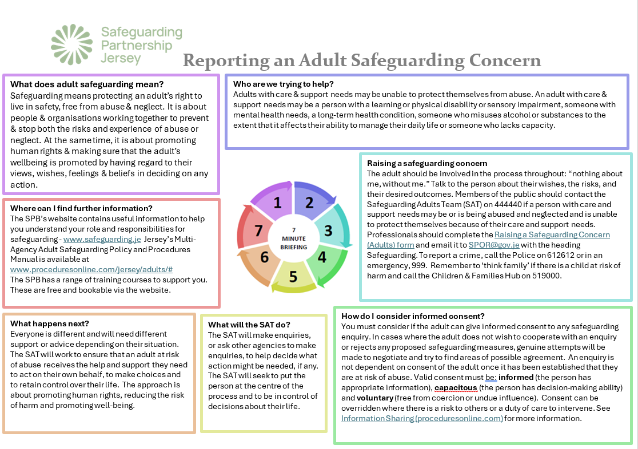

Slide 48
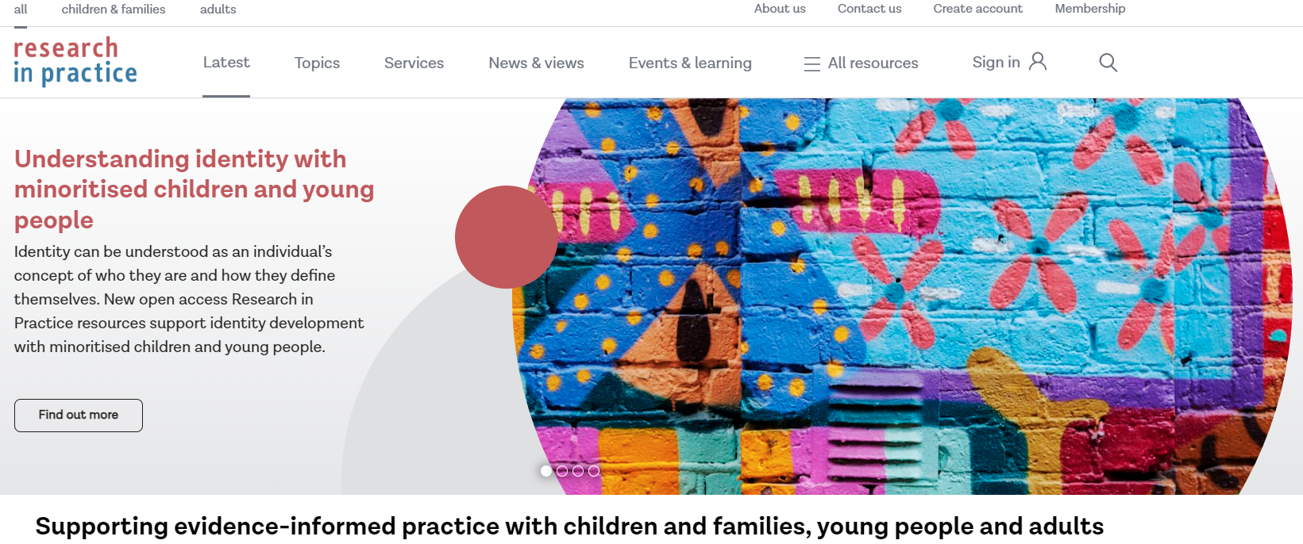

Further Learning
Further training is available to book via the SPJ website.
Materials are also available on the Research in Practice website.

Slide 49
Further reading
Multi Agency Safeguarding Adults Procedures (2021)
www.proceduresonline.com/jersey/adults
SPJ Safeguarding Adults Thresholds Guidance (2021)
pract_guid_threshold_grid.pdf (proceduresonline.com)
SPJ Self Neglect Guidance (2016)
Care Act (2014) Easy Read Version www.gov.uk/government/publications/careact
No Secrets - Guidance on Protecting Vulnerable Adults in Care (2000) www.gov.uk/nosecrets
Social Care Institute for Excellence (SCIE) www.scie.org.uk/adults/safeguarding/
The United Nations Convention on the Rights of People with Disabilities Layout 1 (equalityhumanrights.com)

