Slide 1
Safeguarding
Adult at Risk and Child Foundation Course
Thursday, 12 March 2026

Slide 2






Housekeeping

Slide 3
Today’s Learning Outcomes:
By the end of this course, you will be able to:
Identify the 12 categories of abuse for adults and the 4 categories of abuse for children, along with their signs and indicators, and identify current and emerging risks for children.
Define ‘Adult at Risk’ in the context of Adult Safeguarding and understand the criteria for initiating a Safeguarding Enquiry.
Explain how the Safeguarding Adults procedure promotes the ‘Making Safeguarding Personal’ approach.
Summarise the 5 principles of Capacity as outlined in the Self-Determination and Capacity Law (2016).
Recognise at least 5 barriers to effective safeguarding for both adults, children and young people at risk.
Define the term ‘Safeguarding’ and its relevance to both adults and children.
Understand how societal attitudes, laws and procedures on child abuse have changed over time.
Respond appropriately to concerns about the safety and welfare of an adult, child or young person, following your organisation’s policies and SPB procedures, ensuring you know when and to whom suspected abuse should be reported.

Slide 4
Our Learning Agreement
Offer criticism constructively
Have respect for the feelings, experiences and perspectives of others
Be aware of diversity issues and promote anti-oppressive practice
Respect confidentiality (excluding risk)
Participants to take responsibility for their learning
Participants are learning resources as well as learners

Slide 5

Wellbeing
Notes:
"Before we begin, please be aware that this session includes topics related to safeguarding and may involve discussions of harm, abuse, or neglect. These issues are sensitive, and your wellbeing is our priority. If at any point you feel uncomfortable or need a break, please feel free to step out or speak to a member of staff privately. Support is available throughout and after the session."

Slide 6

Introductions

Slide 7
True or False Quiz

Slide 8
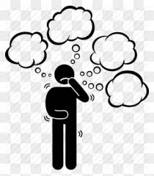
Categories of abuse
Can you name four for children?
Can you name twelve for adults?
Notes:
Invite the group to call out the different types of abuse and a brief explanation for each. And some possible signs and indicators.

Slide 9
Physical Abuse
The non accidental infliction of physical force that results (or could result) in bodily pain, injury or impairment.
Examples of physical abuse are:
  Hitting
  Slapping
  Shaking
  Misusing medication
  Restraint
  Exposure to heat or cold
  Not giving adequate food or drink
For children this may include:
hitting with hands or objects
Slapping, punching, kicking
Shaking, throwing
Poisoning
Burns and scalding
Biting and scratching
Breaking bones
Drowning
Physical harm may also be caused when a parent fabricates the symptoms of or deliberately causes illness in a child

Slide 10
Sexual Abuse
For children, this includes:
Forcing or enticing a child to take part in sexual activities not necessarily involving a high level of violence, whether the child is aware of what is happening
Physical contact: penetrative or non-penetrative, including kissing and touching outside of clothes
Non-physical contact: looking at (including online/phones) or involved in production of pornographic materials, watching sexual activities, grooming
Sexual exploitation
Perpetrators include adult males, females and other children
The direct or indirect involvement in sexual activity without consent.
Sexual Abuse includes:
Rape
Indecent assault and indecent exposure
The involvement of an adult at risk in a sexual activity or relationships which they cannot understand or have been coerced into because the other person is in a position of trust, power or authority

Slide 11
Psychological/Emotional Abuse
Psychological abuse is behaviour that has a harmful effect on emotional health and development.
Psychological abuse includes:
Threats of harm or abandonment
Deprivation of contact
Humiliation
Intimidation
Harassment
Isolation or withdrawal from services or supportive networks
For children this also includes:
Imposing age or developmentally inappropriate expectations, including interactions beyond the child’s developmental capability, as well as overprotection and limitation of exploration and learning
Seeing or hearing the ill-treatment of another, e.g. domestic abuse
Serious bullying causing children frequently to feel frightened or in danger
Exploiting and corrupting children

Slide 12
Neglect or acts of omission
Neglect is the failure of any person who has responsibility for the charge, care or custody of an adult at risk to provide the amount and type of care that a reasonable person would be expected to provide.
Examples of neglect include:
Ignoring medical or physical needs
Failure to allow access to appropriate health, social care or educational services
Withholding the necessities of life such as medication, adequate nutrition and heating
Neglect can be intentional or unintentional.
In children, this includes neglect during pregnancy because of maternal substance misuse, maternal mental ill health or learning difficulties or a cluster of such issues. Where there is domestic abuse towards a carer, the child’s needs may be neglected.
Neglect may involve a parent failing to:
Provide adequate food, clothing or shelter
Protect a child from harm or danger
Ensure adequate supervision
Ensure access to medical care or treatment
Meet basic emotional, social & educational needs

Slide 13
Financial or Material Abuse
Financial abuse is the use of a person’s property, assets, income, funds or any other resources without their informed consent or authorisation.
Financial Abuse includes:
Theft
Fraud
Exploitation
Undue pressure in connection with wills, property or inheritance or financial transactions
The misuse or misappropriation of property, possessions or benefit
The misuse of a Power of Attorney or Curatorship
Notes:
Some signs and indicators
Unusual Financial Activity
Sudden or unexplained withdrawals from ATM/bank accounts.
Unpaid bills or lack of basic necessities despite having adequate finances. Unexplained changes in a will or financial documents
Control or Misuse of Money/Assets
A caregiver or family member taking control of finances without proper consent or legal authority
Missing valuables (jewellery, electronics, personal possessions)
Loss of property, possessions or savings with no clear explanation
Changes in Relationships or Behaviour
An adult expressing anxiety or fear about finances or a particular person
A new or overly involved ‘friend’ or ‘relative’ who appears to control access to the person or their money
Legal and Administrative Concerns
Sudden granting of LPA to someone the adult has not known for long
Signs of Neglect Related to Financial Abuse
Poor personal hygiene or living conditions due to lack of access to funds
No access to required medications, equipment, or care due to apparent lack of money
Red Flags in Context:
Family members or carers seeming over-interested in the adult’s finances
Discrepancies between the adult’s known income and their living conditions
Reports of theft or coercion by the adult or others

Slide 14
Discriminatory Abuse
Discriminatory abuse exists when values, beliefs or culture result in a misuse of power that denies opportunity to some groups or individuals.
It can be a feature of any form of abuse of an adult at risk, but can also be motivated because of age, gender, sexuality, disability, religion, class, culture, language and ‘race’ or ethnic origin.
Notes:
Some Signs and indicators
Verbal or Emotional Abuse
Derogatory or insulting language based on someone’s identity. Mocking, name-calling, or use of slurs. Patronising or infantilising behaviour
Dismissing or minimising cultural, religious, or personal preferences
Behavioural Clues
The adult appears withdrawn, anxious, or fearful around certain people
Low self-esteem or lack of confidence. Reluctance to engage with services or support. Avoidance of certain settings
Denial of Rights or Opportunities
Not being offered services or care due to personal characteristics. Exclusion from decision-making processes.
Lack of respect for religious or cultural practices (e.g. food, dress, or holidays)
Disproportionate use of control, restraint, or restrictions on certain groups
Signs in Care Settings
Lack of diversity or inclusion in care provision. Staff showing bias or favouritism
Policies or practices that indirectly discriminate
Failure to make reasonable adjustments for disabilities or communication needs
Physical Indicators (in some cases)
Unexplained injuries possibly linked to targeted aggression. Signs of neglect due to prejudice (e.g. poor care for a disabled adult)

Slide 15
Institutional Abuse
Institutional abuse is the mistreatment, abuse or neglect of an adult at risk by a regime or individuals within settings and services that adults at risk live in or use, that violate a person’s dignity, resulting in lack of respect for their human rights.
Institutional abuse occurs when the routines, systems and regimes of an institution result in poor or inadequate standards of care and poor practice which affects the whole setting and denies, restricts or curtails the dignity, privacy, choice independence or fulfilment of adults at risk.
Notes:
Some Signs and Indicators
For Individuals (Residents or Service Users):
Loss of autonomy or choice (e.g., fixed meal times, no input into daily routine)
Lack of privacy (e.g., personal care done without dignity).Withdrawal, low mood, or fearfulness. Deterioration in health or hygiene without medical explanation
Unexplained injuries or poor handling
Overuse of medication or sedation. Appearing fearful or anxious around staff
Being treated impersonally (referred to by room number or condition)
For the Environment/Setting:
Strict, rigid routines for all residents with little flexibility. Lack of activities, stimulation, or interaction. Unsafe or unhygienic environment
Staff not involving individuals in decision-making. Absence of personalisation in care (everyone treated the same)
Closed culture: resistance to visitors or external scrutiny. Poor leadership or lack of oversight
Organisational Practices:
Staff speak about people as burdens or objects. Inadequate training or supervision of staff. Lack of safeguarding awareness or whistleblowing culture
Complaints system is ineffective or not encouraged. Poor record-keeping or falsified documentation

Slide 16
Self Neglect
The term “self-neglect” covers a wide range of behaviour neglecting to care for one’s personal hygiene, health or surroundings. Examples of self-neglect include:
A refusal or inability to cater for basic needs, including personal hygiene and appropriate clothing
Neglecting to seek assistance for medical issues
Not attending to living conditions – letting rubbish accumulate in the garden, or dirt to accumulate in the house
Hoarding items or animals
The dilemma of managing the balance between the protection of adults at risk from self-neglect, our duty of care and an individual’s right to self-determination is a recognised challenge for all services.
Notes:
Some Signs and indictors
Personal Appearance and Hygiene
Poor personal hygiene (e.g., strong odour, unwashed clothing)
Wearing inappropriate or soiled clothing. Long or unkempt hair and nails
Untreated medical conditions
Living Conditions
Hoarding (items, rubbish, animals)
Unsafe or unsanitary home environment (e.g., infestations, mould, no running water)
Risk of fire or trip hazards due to clutter. Utilities disconnected or not used (e.g., no heating or lighting)
Nutrition and Health
Malnutrition or dehydration. Sudden or extreme weight loss. Failure to take prescribed medication. Refusal of healthcare or medical appointments. Repeated hospital admissions
Mental and Emotional Health
Social withdrawal or isolation. Depression, anxiety, or confusion
Refusal of support/reluctance to engage with services. Denial of any issues despite clear concerns
Financial and Legal
Not managing bills or finances. Risk of eviction due to unpaid rent or bills

Slide 17
Domestic Abuse
Any incident or pattern of incidents of controlling, coercive, threatening behaviour, violence or abuse between those aged 16 or over who are, or have been, intimate partners or family members regardless of gender or sexuality.
Domestic abuse can take many forms including:
Physical
Emotional
Sexual
Financial
Honour Based Violence
Forced Marriage
Stalking and Harassment
Notes:
The Domestic Abuse (Jersey) Law 2022 provides a more comprehensive and modern legal framework for addressing domestic abuse. It recognises a wide range of abusive behaviours beyond physical violence, including coercive control and financial exploitation, and introduces measures like Domestic Abuse Protection Orders to provide immediate and long-term protection for victims. With these provisions, Jersey aims to improve support for victims, enhance legal safeguards, and ultimately reduce domestic abuse within the community.

Slide 18
Female Genital Mutilation
  FGM is a collective term for procedures which include the removal of part or all of the external female genitalia for cultural or other non-therapeutic reasons. The practice is medically unnecessary, extremely painful and has serious health consequences. The procedure is typically performed on girls aged between 4 and 13, but in some cases it is performed on young women before marriage or pregnancy.
  FGM usually happens to girls whose mothers/grandmothers or extended family have had FGM or if their father comes from a practicing community. If you become aware of FGM in adults, you should ‘think family’ and consider whether there are risks to any female children in the family.

Slide 19
Modern Slavery
Modern slavery includes offences such as human trafficking, slavery, servitude and forced labour. Victims, both adults and children, are exploited in various ways, with sexual exploitation, labour exploitation and criminal exploitation being the most common in the UK. Other forms of exploitation include domestic servitude and organ harvesting.
Modern slavery crimes include facilitating travel to exploit a person. While trafficking often involves crossing borders, it can also happen locally.
Jersey is not exempt; modern slavery has grown in the UK and similar crimes can occur here.
Notes:
UK case in May 2023 A senior Nigerian senator, his wife and doctor imprisoned 05/05/2023 for exploiting a vulnerable victim for illegal organ harvesting. Sentences 9 yr 8 months, 4 yrs 10 months and 10 years.

Slide 20
Hate and Mate
Crime
Hate and Mate Crime refers to acts of violence or hostility directed at people due to who they are or who someone perceives them to be. Hate crimes are motivated by prejudice based on disability, race, religion, sexual orientation or gender identity. Mate crime, on the other hand, occurs when someone befriends a vulnerable person with the intention to exploit them financially, physically or sexually. The relationship starts as a fake friendship, but the perpetrator’s goal is criminal and it often leads to ongoing abuse.
People with learning disabilities are especially vulnerable to mate crimes because they may live isolated lives and are more likely to trust others for companionship. Due to limited ‘streetwise’ experience, they are more susceptible to exploitation in the community, on public transport or while using services without proper support.
Notes:
Hate crimes target individuals based on group characteristics and involve violence or hostility motivated by prejudice or hatred. These crimes are criminal acts that are rooted in discrimination.
Mate crimes involve the exploitation of vulnerable people by those who pretend to be friends or trusted individuals, with the aim of personal gain through abuse or manipulation.
Both are harmful forms of abuse that require awareness, education, and strong protective systems to prevent and address.

Slide 21

Coffee

Slide 22

Who is an ‘Adult at Risk’
In groups, define who is an ‘adult at risk’
Notes:
Activity 1 – what do you think we mean when we say an adult at risk- group activity discuss
Think age

Slide 23
‘Adult at Risk’
As stated in the UK Care Act 2014: an adult at risk refers to any adult aged 18 or over who
Has care and support needs (irrespective of whether such needs are being met)
Is experiencing, or is at risk of, abuse or neglect
Is unable to protect themselves because of their care and support needs
Everyone working to support people with care and support needs has a responsibility within these multiagency adult safeguarding procedures to identify and respond to concerns about possible abuse and neglect.
(SPJ Multi Agency Safeguarding Adults Policy and Procedures 2021)
Notes:
There is a very clear definition within our local procedures which outlines exactly what constitutes an adult at risk

Slide 24
An adult with care and support needs may be:
A person with a physical disability, a learning disability or a sensory impairment.
Someone with mental health needs, including dementia or a personality disorder.
A person with a long-term health condition.
Someone who misuses alcohol or substances to the extent that it affects their ability to manage day-to-day living.
Someone who is unable to demonstrate the capacity to make a decision relating to their safety and is in need of care and support.
(this list is not exhaustive)
Note: A person who is a carer can also be considered an adult risk if they meet the criteria for safeguarding.

Slide 25
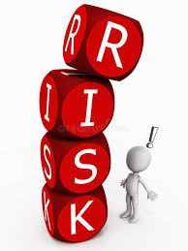
Adult with Care and Support Needs.
Yes or No?
Notes:
Activity 2 -

Slide 26
Initiating Adult Safeguarding Procedure
A Safeguarding Adults Procedure would be initiated when an adult with care and support needs is experiencing abuse or is at risk of being abused and is unable to protect themselves because of their care and support needs.
Adult with Care and Support Needs + Abuse + Unable to protect themselves = Adult Safeguarding

Slide 27

Safeguarding – Yes or No?

Slide 28

What is the difference between
Safeguarding Adults
and
Safeguarding Children ?
Notes:
What you are looking for here is that safeguarding adults in not statutory and we follow “Good Practice” , but children there is a legal framework to do so.

Slide 29
Safeguarding Adults
  Governed by laws like the Care Act 2014 in England, followed in Jersey as good practice.
  Focuses on the empowerment and autonomy of adults, respecting their right to make decisions about their own lives. MSP; no decision about me without me.
  Involves a duty of care but also recognises that adults have the right to make unwise decisions if they have the capacity to do so.
Safeguarding Children
Governed by laws such as the Children and Young People (Jersey) Law 2022 and guidance under Jersey Children First (Children Act 1989 and 2004 in the UK).
  Emphasises the best interests of the child as the primary consideration.
  Involves mandatory reporting obligations for professionals when there is concern for a child's welfare.

Slide 30
Human Rights

Slide 31

Human Rights are the basic rights and freedoms that belong to every person in the world from birth until death.
They can never be taken away, although they can sometimes be restricted or limited e.g. Article 5 right to liberty.
These rights come from the European Convention on Human Rights which are written into the Human Rights (Jersey) Law 2000.
Human Rights should underpin all our work with people we are supporting.

Slide 32

The CSDL establishes safeguarding for people who lack capacity and ensures human rights principles are at the forefront of care and treatment for people who lack capacity.
These rights come from the European Convention on Human Rights and are written into the Human Rights (Jersey) Law 2000.
Relevant rights include;
  Article 5: right to liberty
  Article 6: Right to a fair hearing
  Article 8: Right to respect for private and family life
Notes:
Other Human rights legislation which could be considered in MSP are. UN Principles for Older Persons 1991 and UN and EU convention on the rights of persons with disabilities.

Slide 33

Making Safeguarding Personal (MSP)

Slide 34
Making Safeguarding Personal (MSP)
MSP is the way of working that promotes human rights.
MSP promotes responses to safeguarding situations in a way that enhances a person’s involvement, choice and control as well as improving quality of life, well-being and safety – “no decision about me, without me”.
Sees people as experts in their own lives, working alongside them to identify the outcomes they want with the aim of enabling them to resolve their circumstances and support their recovery.
MSP means that safeguarding:
Is person led
Enhances involvement, choice and control
Is outcome-focused
Improves quality of life, wellbeing & safety
Making Safeguarding Personal
Notes:
MSP is person-led, enhances involvement and choice, is outcome-focused and improves quality of life, wellbeing and safety.

Slide 35
Consent

Slide 36

Care Act 2014 (England and Wales/UK) - Consent
There is a duty of care to undertake an assessment of the adult’s care and support needs despite their refusal in cases;
where they lack capacity to refuse the assessment and it would be in their best interest
where the adult is experiencing, or at risk of abuse or neglect, there is a duty of care to intervene, for example, a serious crime has been or may be committed or there is a serious risk to life
there is a risk to others.
In cases where the adult does not wish to co-operate with an enquiry or rejects any proposed safeguarding measures, genuine attempts will be made to negotiate and try and find areas of possible agreement.
(Recording these discussions is essential)

Slide 37

Explore the reasons for the adult's objections – what are they worried about?
Explain the concern and why you think it is important to share the information.
Tell the adult with whom you may be sharing the information with and why.
Explain the benefits to them, or others, of sharing information – could they access better help and support?
Discuss the consequences of not sharing the information – could someone come to harm?
Reassure them that the information will not be shared with anyone who does not need to know.
Offer the reassurance that support is available to them.

Slide 38

Capacity and Self Determination Law (2016)
The CSDL affects all people aged over 16.
The CSDL supports people’s decision-making, including future decisions.
The CSDL provides a legal framework for assessing capacity and making decisions for those who lack capacity.

Slide 39
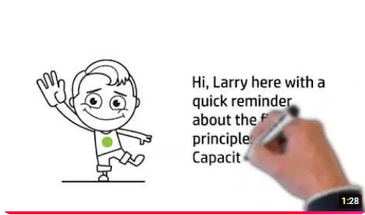
Explaining Capacity
The 5 Principles of the Mental Capacity Act

Slide 40
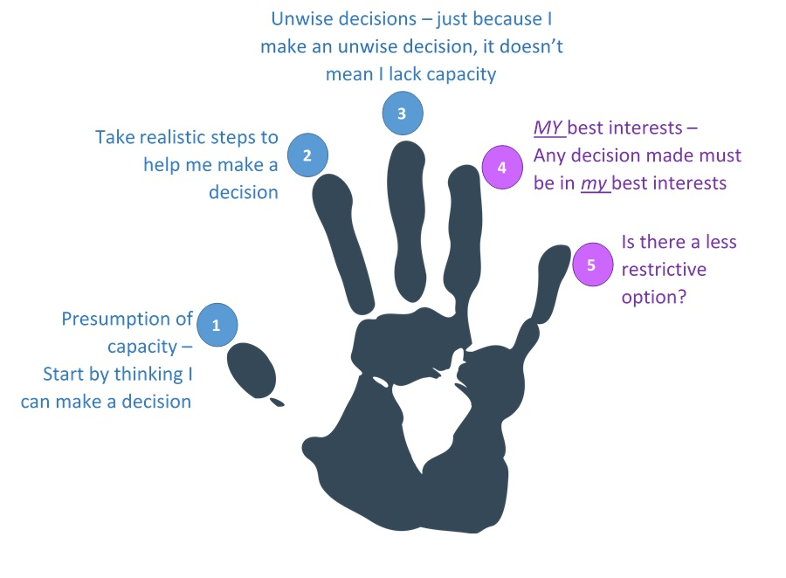
Five Principles of the Law
a person must be assumed to have capacity unless it is established that they lack capacity
a person is not to be treated as unable to make a decision unless all practicable steps to support them to do so have been taken without success
a person is not to be treated as unable to make a decision merely because they make an unwise decision
an act done, or decision made, under the Law for or on behalf of a person who lacks capacity must be done, or made, in their best interests
before an act is done, or a decision made which is restrictive of a person’s rights and freedom of action, regard must be had to whether the purpose for which it is needed can be achieved as effectively in a less restrictive way
The Capacity Law and its Code of Practice –
Jersey Court Service
Notes:
The first 3 principles are to safeguard the individual from any unnecessary interference in their lives , principles 4 and 5 are used when a person lacks capacity and provide the basis on which we should make a decision for other people.

Slide 41
What would you do?

Slide 42

Harry, a 35 -year-old with capacity living in the community, falls and is unable to take care of his basic needs. Do you need his consent to contact SPOR for a social care assessment?
Sophie, a 35 year with complex needs, is being sexually abused by one of her care workers. Do you need her consent to report the abuse?
Gerry, a 50-year-old who has a disability but has capacity, lives in squalid conditions. A local gang is exploiting him for money and threatened violence if he does not comply. Do you need consent to make an enquiry to SPOR?
Fred, a 67-year-old man who is reliant on his family for care, is being pressured by his family to change his will. The family have said they will not care for him in future unless he changes it. Do you need his consent to make an enquiry to SPOR?
Notes:
Harry, a 35 year old with capacity living in the community, falls and is unable to take care of his basic needs. Do you need his consent to contact SPOR for a social care assessment?
Yes consent required
Sophie, a 35 year with complex needs, is being sexually abused by one of her care workers. Do you need her consent to report the abuse?
No Consent not required – risk to others
Gerry, a 50 year old who has a disability but has capacity, lives in squalid conditions. A local gang is exploiting him for money and threatened violence if he does not comply. Do you need consent to make an Enquiry to SPOR
No consent required – Gerry is being coerced ( threatened) and there is a threat to others .
Fred – No consent, coerced and threatened

Slide 43

Scenario Activity
Is Ben an adult at risk?
What are your concerns about Ben?
What questions will you need to ask Ben using the MSP approach and what will you need to understand?
Do you need Ben’s consent to make an enquiry?
Do you think he has capacity?
What do you do with the information?

Slide 44
Child Safeguarding

Slide 45
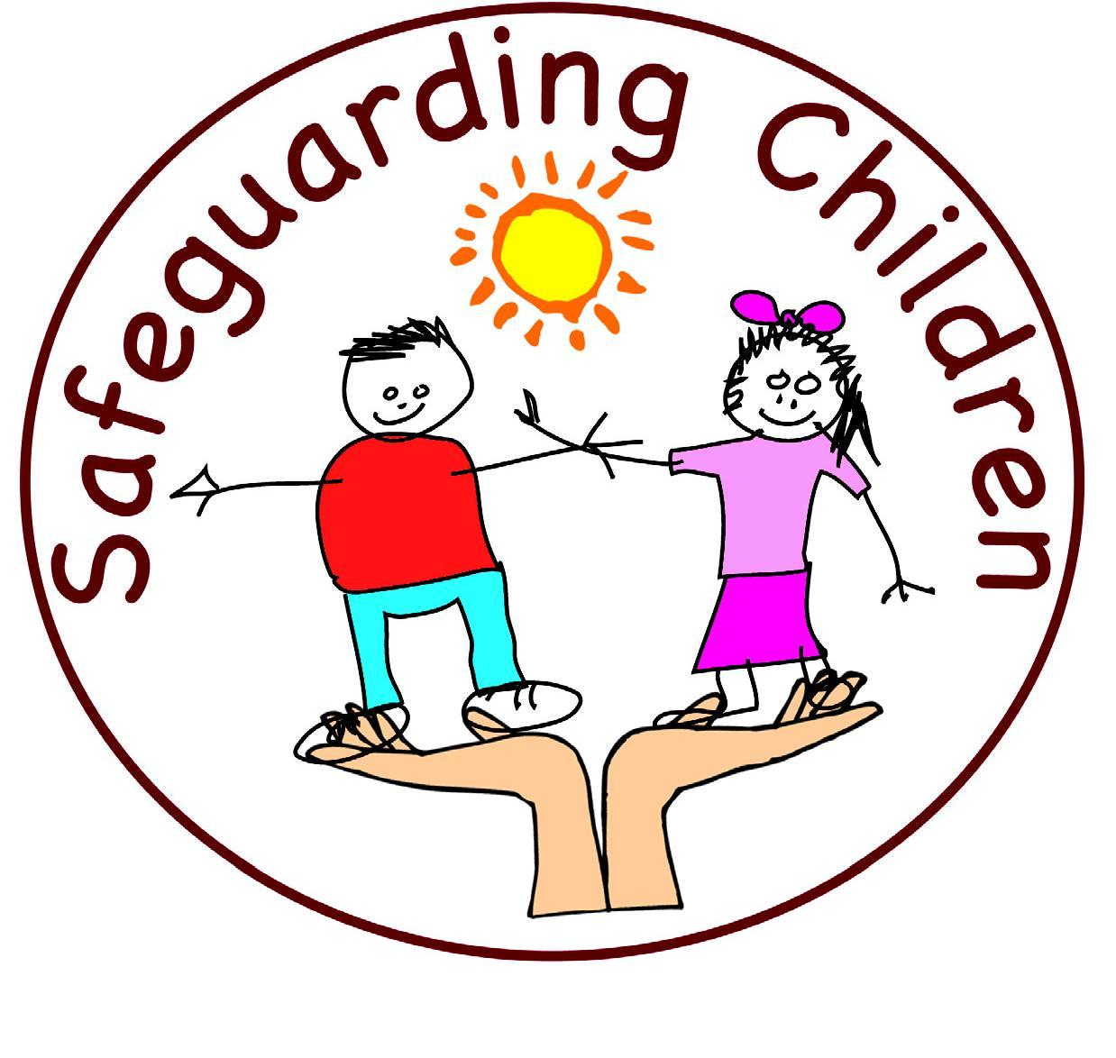
Safeguarding
Safeguarding means acting to protect children, young people and adult’s rights to live a life in safety, free from harm, abuse, neglect and exploitation.
Promoting Wellbeing and Safeguarding children, young people and adults is a collective responsibility and is an integral part of providing high quality care.
Safeguarding Partnership Jersey
Child Protection Procedures.
Notes:
This is safeguarding definition

Slide 46
Safeguarding Need
A Safeguarding Need (previously Child Protection) refers to the activity that is undertaken to protect specific children who are suffering, or are likely to suffer, significant harm.
Effective Safeguarding is essential as part of wider work to promote the welfare of children. However, all agencies and individuals should aim to proactively safeguard and promote the welfare of children so that the need for action to protect children from harm is reduced.

Slide 47
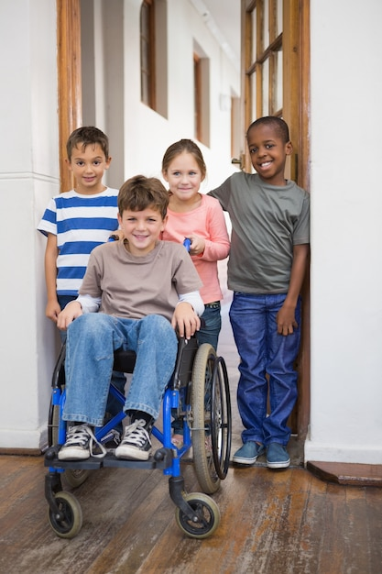
Jersey’s Children First
Jersey’s Children First is the vehicle for delivering the 5 outcomes of The Children and Families Plan 2024–2027. It is the Government's strategic plan to align systems and agencies, ensuring all children have an equal opportunity to be safe, thrive, and reach their potential through five key outcomes:
Live healthy, happy lives.
Learn and achieve.
Enjoy a decent standard of living.
Grow up safely.
Be included, respected and valued.
It is a mandatory requirement that Practitioners work together effectively to meet wellbeing, health and development needs and to promote and safeguard the welfare of children and young people.
Notes:
It is a mandatory requirement that Practitioners work together effectively to meet wellbeing, health and development needs and to promote and safeguard the welfare of children and young people. Highlight this is the island plan, and further information can be found on gov.je the previous plan had 4 outcomes, the new plan has added Enjoy a decent standard of living.

Slide 48
Jersey’s Children First
Standard framework.
Sets out how to work together to ensure children, young people and their families can access the right help at the right time from the right services.
Envisions a seamless multi-agency approach so that resources, information and support move with the child as they grow and develop.
At its heart is a commitment to early intervention and prevention for children which is coordinated around children and families when needed.
Information on how to access this training is at gov.je
Notes:
There is a step up/down approach - next slide shows the continuum of need model
Focus - Pre birth to 19 years

Slide 49
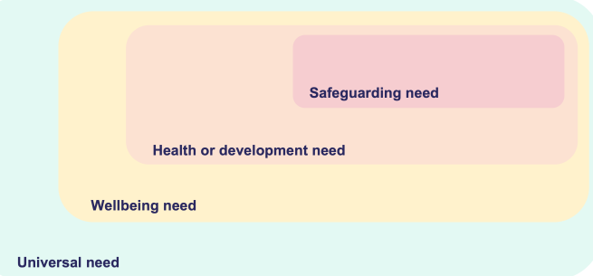
Jersey’s Children First
Informed by the Children (Jersey) Law 2002 and Children and Young People (Jersey) Law 2022 Statutory Guidance, the Continuum of Need tool identifies four levels of vulnerability, risk and need to assist practitioners to identify the more appropriate service response for children and their families. These are:
Child Protection
Child in Need
Early Help
Universal Need
Notes:
Children can move between the different levels
Safeguarding need ( child protection ) – no consent required – likely or is suffering from significant harm.,
Health and development need (child in need) no consent required – complex needs and need to support for health /disability would have SW , CAMHS pediatrician
Wellbeing need ( early help) consent required to share child may need emotional support, or family support
Universal need – consent required - share information shelter, food, clothing, medical care and protection from harm.
Right help at the right time
Knowledge is required at practitioner level, but it is useful to know the terminology and how the children may step up or down between the levels.

Slide 50
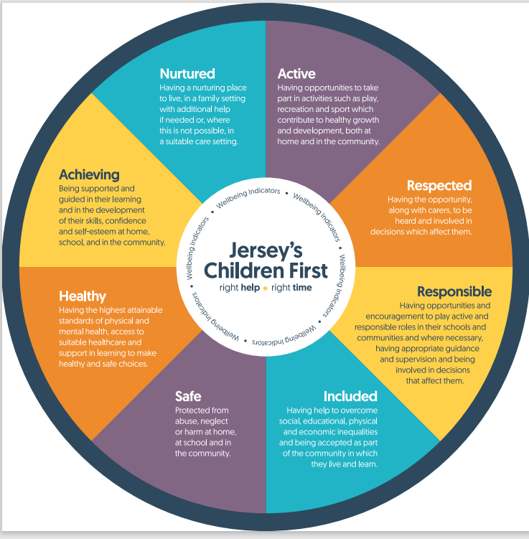
Children and Young People (Jersey) Law 2022
Notes:
These are the 8 wellbeing indicators prescribed in the Law. The wheel is a tool to help identify wellbeing needs in children and use of the language helps in the referral process, along with the continuum of need document.

Slide 51
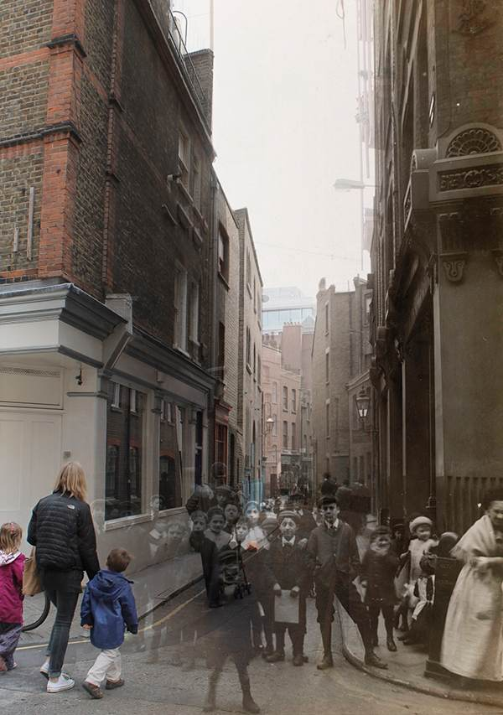
Child Abuse: A timeline of changing beliefs, values and attitudes.
Notes:
Activity 3 groups – put the timeline papers in the correct order that you think that these occurred – 10 mins

Slide 52

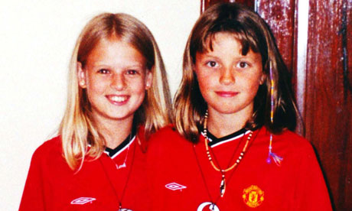
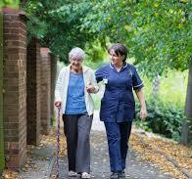
2002 The Children (Jersey) Law.
2004 The Bichard Inquiry into the Soham murders (Holly Wells and Jessica Chapman) recommended a registration scheme for those working with children and vulnerable adults. This resulted in the Independent Safeguarding Authority responsible for the Vetting and Barring Scheme.
2016 The Capacity and Self-Determination (Jersey) Law introduced that everyone over the age of 16 must be assumed to have capacity, unless shown otherwise. The Law came into force in 2018.

Slide 53
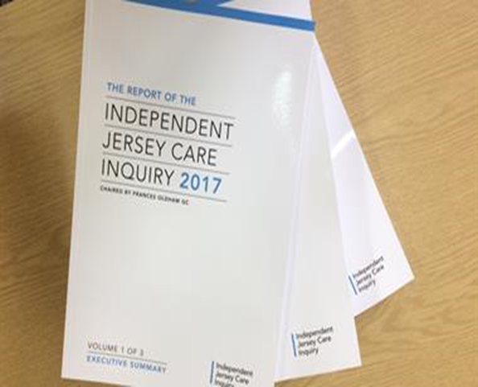


2017 Independent Care Inquiry published, and Jersey’s Children’s Commissioner appointed.
2018 Sexual Offences (Jersey) Law offers greater protection to victims including up skirting and FGM. It also widens the definition of ‘positions of trust’ and clarifies issues around consent.
2018 also saw the launch of a new standard practice model in Jersey – Jersey’s Children First.
2024 the Children and Young People (Jersey) Law 2022 is enacted. Statutory guidance is published and online training provided alongside Safeguarding Arrangements documents.

Slide 54
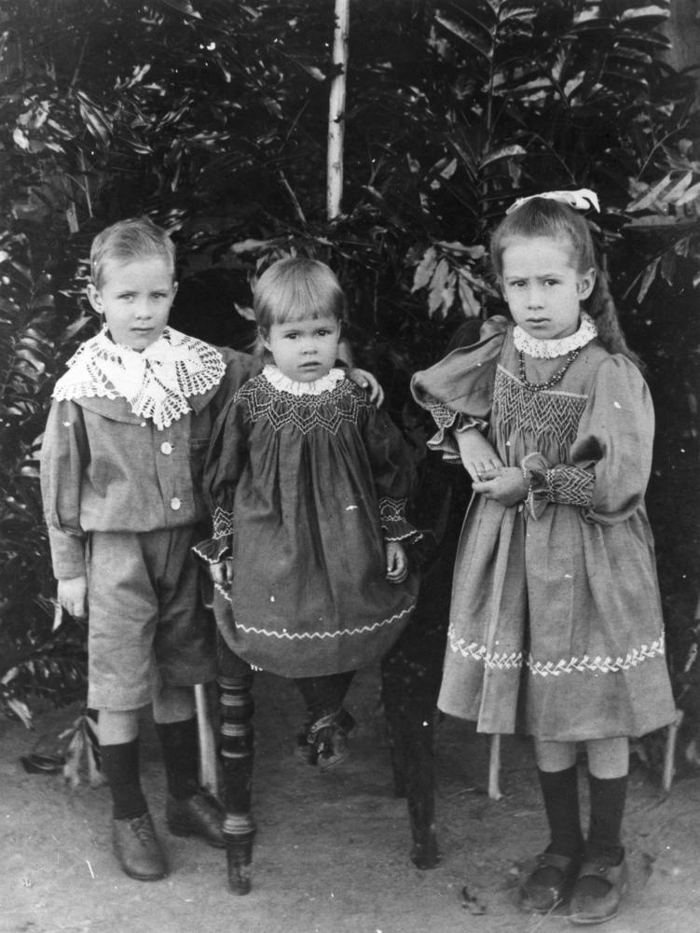
Changing beliefs and Values
Our values, beliefs and attitudes towards children have changed dramatically over the past few hundred years. We now have a duty to listen to children and put them first.
Is this enough? What will future generations think of how we treat children now?

Slide 55
Child Scenarios
What is getting in the way of this child’s wellbeing?
How might these issues be impacting on the child right now?
How might these issues impact on the child in future?
Are there additional needs that you should consider?
What will you do with this information?

Slide 56
Barriers to Safeguarding
Notes:
They may not understand what is happening to them – Disability, cognitive, it’s the “norm”
Guilt and blame
Ashamed embarrassed
People won't believe them
May not be able to communicate verbally – you would need to watch for signs of behavioral changes
Afraid of the consequences of speaking out
Hope that the abuse will stop

Slide 57

Enablers to Safeguarding
Notes:
Activity 6
Children – focus on what helps them tell
Positive relationships
Knowing who to tell
Knowing their rights
Being heard
Being believed /not judged
Adults
good training
Professional curiosity
Good communications/relationships
Person centered
Empathy/non judgmental
Consideration for their needs

Slide 58
Current and Emerging Risks

Slide 59
Child exploitation - Sexual and Criminal.
Online & Digital risks - Cyber bullying, online harassment & AI.
Vulnerabilities in families - Domestic Abuse, Controlling Coercive Behaviour, substance misuse, parent/child mental health.
Radicalisation - Political, far right/left, ideologies, incels (involuntary celibates).
Modern Day Slavery - Domestic servitude.
Trafficking - County lines, Child Criminal Exploitation, Child Sexual Exploitation, forced labour.
Forced Marriage - Forced marriage by coercion/threat and without free will.
Female Genital Mutilation - Nonmedical procedure against women and girls.
And Covid…
…Mental health, social wellbeing affecting health and development.
Notes:
Covid – has led in some cases to children lacking in socialisation – think how lock downs prevented mixing and the impact. Developmental delay.
Some cases poor parenting children not toilet trained and when started nursery were behind the expected developmental milestones.
You could promote Brook Traffic Light training as it highlights normal and concerning behaviours. Incel is a term associated with a mostly online subculture of male heterosexual people who define themselves as unable to find a romantic or sexual partner despite desiring one, and who may blame, objectify and denigrate women and girls as a result.

Slide 60
Addressing current and emerging risks

Slide 61
To safeguard children effectively in the face of these emerging risks, ongoing education, training, awareness and cooperation between government bodies, schools, families and technology companies are necessary. Comprehensive approaches to address both the traditional and emerging threats are required, including:
Strengthening online safety laws and regulations.
Providing better mental health support for children.
Ensuring accessible reporting systems for abuse and exploitation.
Promoting digital literacy to help children navigate online risks.
Supporting vulnerable families and children with integrated services.

Slide 62
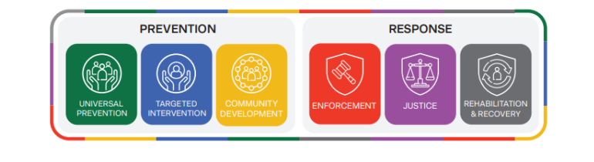
Building A Safer Community (BASC)
The purpose of BASC is to provide a framework that enhances the collective impact of partner agencies in protecting the community from crime.
Notes:
This is Jersey’s new community safety system, there are 2 main phrases , Prevention and response. Each phase has 3 pillars. The BASC Framework is the Government of Jersey’s collaborative approach to making the island safer for everyone. It brings together services, organisations, professionals, and the community to:
Prevent and respond to safety issues before they escalate
Share knowledge and data to better understand and address community safety issues
Promote collaboration
Reduce crime and reoffending
Ensure victims, witnesses, and affected communities receive the support they need to recover and thrive
Universal prevention
Focuses on preventing issues before they occur.
Address underlying risk factors, like supporting children’s social and emotional needs to reduce future criminality
Targeted intervention
Provide support when specific risks are identified.
Offer pre-emptive help to businesses, individuals, or families at risk of criminal behaviour.
Community development
Strengthen communities to reduce susceptibility to crime.
Leverage local assets (skills, resources) to build resilience and foster social innovations.
Response
address crime effectively and sensitively.
Support offenders, victims, witnesses, and the community in the aftermath.
Enforcement
Investigate and prosecute crimes.
Support victims and witnesses to reduce trauma.
Justice
Formal court proceedings from charges to sentencing.
Focus on supporting victims and witnesses during the process.
Rehabilitation and recovery
Help offenders reintegrate and reduce reoffending.
Support victims and the community in healing from the harm caused.

Slide 63
Violence Against Women & Girls (VAWG)
Violence against women and girls is any act of gender-based violence that results in, or is likely to result in, physical, sexual or psychological harm or suffering to women, including threats of such acts, coercion or arbitrary deprivation of liberty, whether occurring in public or in private life.
Violence against women and girls refers to acts of violence or abuse that disproportionately affect women and girls. Although women and girls are mostly affected, men and boys can also be victims of this type of violence. Lesbian, gay, bisexual or transgender people can also be victims of this type of violence, often due to their sexual orientation or gender identity.
You can be a victim or witness gender-based violence in your family, at school, at work, in the community or online. It can be committed by anyone.
VAWG Taskforce Report.pdf
Notes:
It can be committed by anyone:
current or previous spouse or partner
family member
school peers
work colleague
Friends
unknown person
Nb. this initiative does not negate/ignore the fact that males can be victims of violence and domestic abuse as well as females.

Slide 64
Child Exploitation
New Guidance and Chapters; Safeguarding Children from Criminal Exploitation
New Jersey Exploitation Screening Tool for multi-agency practitioners, completed by referring agency.
Child Exploitation Risk Assessment Information Form; information is assessed by MASH, CE lead (CSC), Police Detective Superintendent (DS)
Jersey Child Exploitation Pathways.
Notes:
In May 2025, new Child Exploitation Guidance and Chapters published to address the growing concerns around the exploitation of children and young and people in Jersey.
The screening tool is completed by the person referring to the children and family hub – usually a practitioner, it is then assessed using the risk assessment tool, by the hub and the professionals required and then a decision will be made about where the child will be in the pathway

Slide 65
Know when & to whom abuse should be reported

Slide 66
In all cases:
Seek medical attention if needed
Preserve evidence
Aim to minimise the risk of further harm
Reassure the person
Aim to minimise the risk of intimidation by any alleged perpetrator
Obtain only sufficient information to be able to tell the police, medical personnel or management what is believe to have happened, when and where
If a crime has been alleged contact the police:
999 for an emergency (e.g rape, physical assault, robbery)
The police station (612300 or 612612) for a crime where a safeguarding issue is not alleged/suspected (e.g property has been stolen by another service user)
The Public Protection Unit (PPU) if a safeguarding issue is suspected (e.g adult at risk being seen with unexplained bruises following a family visit)
DO NOT interview any alleged perpetrator
Notify the manager or nominated senior person on duty ASAP

Slide 67
If you have any safeguarding concerns about the welfare or safety of an adult at risk you should discuss this with your line manager and/or designated safeguarding lead where possible for support & advice
If you are unsure your concerns warrant an enquiry, or you need further advice contact SPOR (Single Point of Referral) at spor@health.gov.je or on 444 440
To make an Adult Safeguarding Enquiry complete a Safeguarding Enquiry form and send it to SPOR. In cases of emergency call SPOR immediately to share concerns
If a concern relates to registered premises the Jersey Care Commission must also be notified on Tel: 445801 or notifications@carecommission.je
The SPB Multi Agency Adult Procedures are now online www.safeguarding.je

Slide 68
Children and Families Hub
The Children and Families Hub provides a single point of contact for children, young people and families who require additional support to ensure they are safeguarded and protected.
Contact the Children and Families Hub on 01534 519000 or email childrenandfamilieshub@gov.je
The Children and Families Hub electronic referral form (which replaces MASH Enquiry Form and Early Help Referral Forms) can be accessed at Children and Families Hub (gov.je)
Out of hours service will operate at other times. The Duty Social Worker can be reached by calling the Hub on 01534 519000 and selecting Option 4 or via the Hospital Switchboard on 442000.

Slide 69
Summary of todays learning.
We use a human rights/MSP approach when working with adults, this means that they are involved as much as possible throughout – “no decision about me, without me”
There are many common signs and indicators of abuse, you must base your concerns on your knowledge and understanding of the specific child/adult at risk and their circumstances.
Professionals must recognise the barriers which can prevent effective safeguarding of adults at risk and children and remember to never lose sight of the adult/child.
It is essential to discuss any concerns with your line manager or designated safeguarding lead. However, in certain situations, you may need to initiate an adult or child safeguarding enquiry without their knowledge or consent—such as when the line manager is the alleged perpetrator or if no manager is available to report concerns to.
It is important to share your concerns with your Line Manager or Designated Lead for any concerns you have. Remember your information may be a ‘vital part of the jigsaw.’ no matter how small.

Slide 70

Any Questions?

Slide 71

Further Learning
The SPJ website (www.safeguarding.je) has a series of 7 Minute Briefings on a range of topics which you can use with your teams to prompt discussion and reflection on practice and systems. You can find 7 Minute Briefings under the ‘Resources’ tab on the website – including an explanation of what they are.
Notes:
7MB on ACEs and GCP2 and Neglect.
Training on GCP2

Slide 72
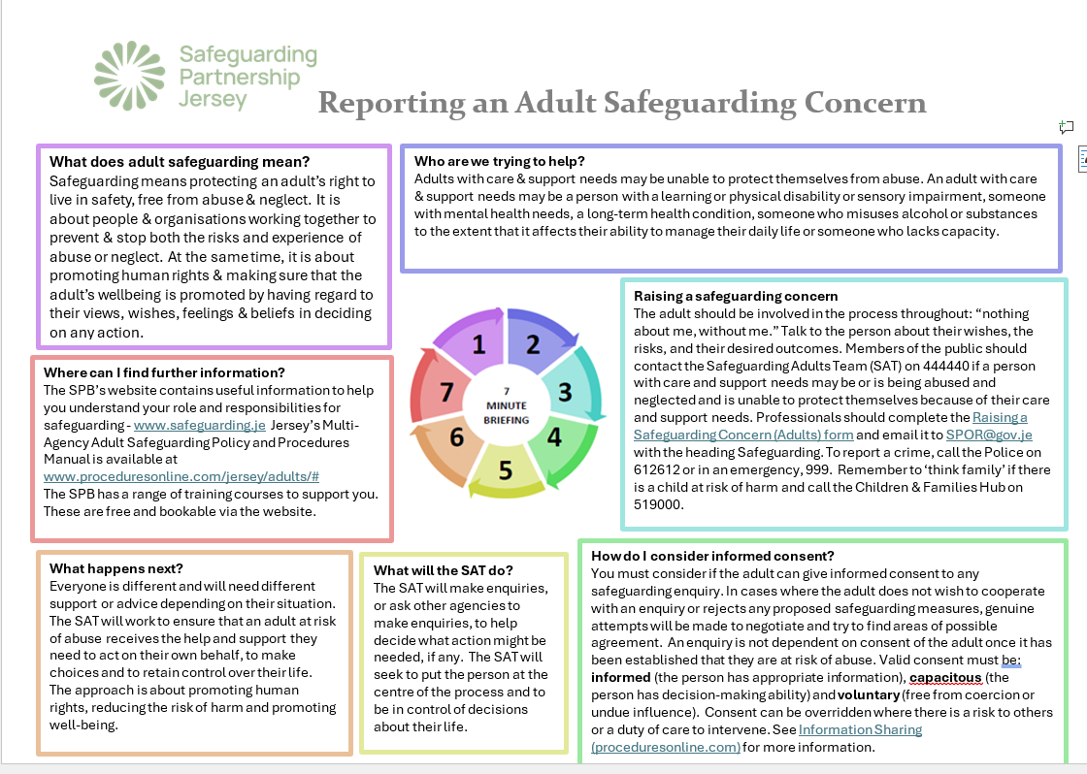

Slide 73
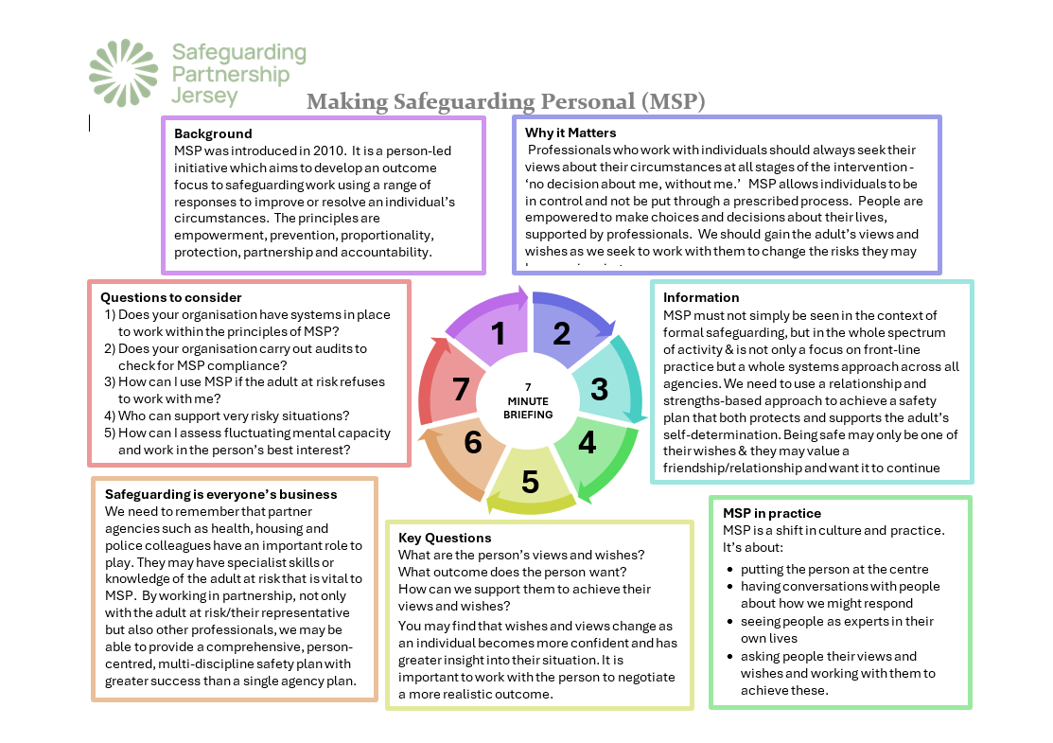

Slide 74
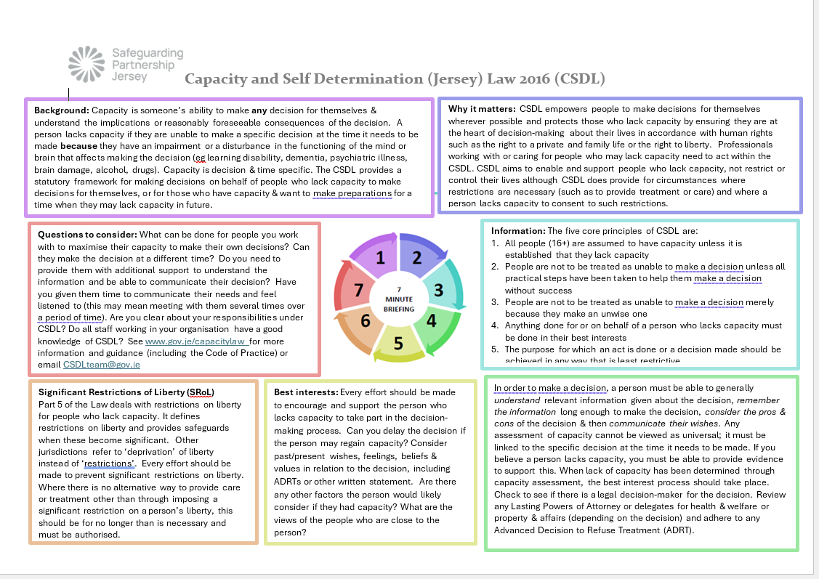

Slide 75
Further Information
SPJ Multi Agency Child Procedures are online www.safeguarding.je
Further training can be found on www.safeguarding.je
Jersey Children’s First Training can be found at www.gov.je/Caring/JerseysChildrenFirst/Pages/GuidancePractitioners.aspx
Island Plan can be found Children and Young People's Plan 2024 to 2027
SPJ Multi Agency Adult Procedures are now online www.safeguarding.je

Slide 76
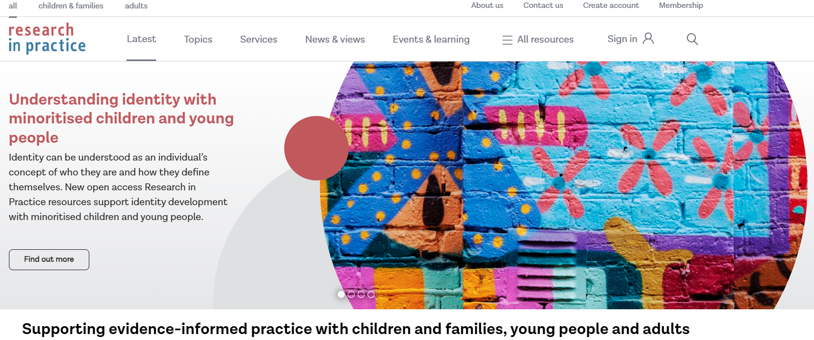

Further Learning
Materials are also available on the Research in Practice website.
Further training is available to book via the SPJ website.

